Slide 1

Chapter 10
File I/O
Slides prepared by Rose Williams, Binghamton University
Kenrick Mock, University of Alaska Anchorage
Copyright © 2017 Pearson Ltd. All rights reserved.

Slide 2
Streams
A stream is an object that enables the flow of data between a program and some I/O device or file
If the data flows into a program, then the stream is called an input stream
If the data flows out of a program, then the stream is called an output stream

Slide 3
Streams
Input streams can flow from the keyboard or from a file
System.in is an input stream that connects to the keyboard
Scanner keyboard = new Scanner(System.in);
Output streams can flow to a screen or to a file
System.out is an output stream that connects to the screen
System.out.println("Output stream");

Slide 4
Text Files and Binary Files
Files that are designed to be read by human beings, and that can be read or written with an editor are called text files
Text files can also be called ASCII files because the data they contain uses an ASCII encoding scheme
An advantage of text files is that the are usually the same on all computers, so that they can move from one computer to another

Slide 5
Text Files and Binary Files
Files that are designed to be read by programs and that consist of a sequence of binary digits are called binary files
Binary files are designed to be read on the same type of computer and with the same programming language as the computer that created the file
An advantage of binary files is that they are more efficient to process than text files
Unlike most binary files, Java binary files have the advantage of being platform independent also

Slide 6
Writing to a Text File
The class PrintWriter is a stream class that can be used to write to a text file
An object of the class PrintWriter has the methods print and println
These are similar to the System.out methods of the same names, but are used for text file output, not screen output

Slide 7
Writing to a Text File
All the file I/O classes that follow are in the package java.io, so a program that uses PrintWriter will start with a set of import statements:
import java.io.PrintWriter;
import java.io.FileOutputStream;
import java.io.FileNotFoundException;
The class PrintWriter has no constructor that takes a file name as its argument
It uses another class, FileOutputStream, to convert a file name to an object that can be used as the argument to its (the PrintWriter) constructor

Slide 8
Writing to a Text File
A stream of the class PrintWriter is created and connected to a text file for writing as follows:
PrintWriter outputStreamName;
outputStreamName = new PrintWriter(new
FileOutputStream(FileName));
The class FileOutputStream takes a string representing the file name as its argument
The class PrintWriter takes the anonymous FileOutputStream object as its argument

Slide 9
Writing to a Text File
This produces an object of the class PrintWriter that is connected to the file FileName
The process of connecting a stream to a file is called opening the file
If the file already exists, then doing this causes the old contents to be lost
If the file does not exist, then a new, empty file named FileName is created
After doing this, the methods print and println can be used to write to the file

Slide 10
Writing to a Text File
When a text file is opened in this way, a FileNotFoundException can be thrown
In this context it actually means that the file could not be created
This type of exception can also be thrown when a program attempts to open a file for reading and there is no such file
It is therefore necessary to enclose this code in exception handling blocks
The file should be opened inside a try block
A catch block should catch and handle the possible exception
The variable that refers to the PrintWriter object should be declared outside the block (and initialized to null) so that it is not local to the block

Slide 11
Writing to a Text File
When a program is finished writing to a file, it should always close the stream connected to that file
outputStreamName.close();
This allows the system to release any resources used to connect the stream to the file
If the program does not close the file before the program ends, Java will close it automatically, but it is safest to close it explicitly

Slide 12
Writing to a Text File
Output streams connected to files are usually buffered
Rather than physically writing to the file as soon as possible, the data is saved in a temporary location (buffer)
When enough data accumulates, or when the method flush is invoked, the buffered data is written to the file all at once
This is more efficient, since physical writes to a file can be slow

Slide 13
Writing to a Text File
The method close invokes the method flush, thus insuring that all the data is written to the file
If a program relies on Java to close the file, and the program terminates abnormally, then any output that was buffered may not get written to the file
Also, if a program writes to a file and later reopens it to read from the same file, it will have to be closed first anyway
The sooner a file is closed after writing to it, the less likely it is that there will be a problem

Slide 14
File Names
The rules for how file names should be formed depend on a given operating system, not Java
When a file name is given to a java constructor for a stream, it is just a string, not a Java identifier (e.g., "fileName.txt")
Any suffix used, such as .txt has no special meaning to a Java program

Slide 15
A File Has Two Names
Every input file and every output file used by a program has two names:
The real file name used by the operating system
The name of the stream that is connected to the file
The actual file name is used to connect to the stream
The stream name serves as a temporary name for the file, and is the name that is primarily used within the program
파일은 2가지 이름이 있다
진짜 파일 이름
파일과 연결되는 stream 이름
File streamName = new File(“realName.txt”)

Slide 16
IOException
When performing file I/O there are many situations in which an exception, such as FileNotFoundException, may be thrown
Many of these exception classes are subclasses of the class IOException
The class IOException is the root class for a variety of exception classes having to do with input and/or output
These exception classes are all checked exceptions
Therefore, they must be caught or declared in a throws clause

Slide 17
Unchecked Exceptions
In contrast, the exception classes NoSuchElementException, InputMismatchException, and IllegalStateException are all unchecked exceptions
Unchecked exceptions are not required to be caught or declared in a throws clause

Slide 18
Pitfall: a try Block is a Block
Since opening a file can result in an exception, it should be placed inside a try block
If the variable for a PrintWriter object needs to be used outside that block, then the variable must be declared outside the block
Otherwise it would be local to the block, and could not be used elsewhere
If it were declared in the block and referenced elsewhere, the compiler will generate a message indicating that it is an undefined identifier
Try block도 block이기 때문에 try안에 변수를 선언하면 local처럼 사용돼서 try밖에서 사용하지 못한다
따라서 변수는 밖에 선언하고 안에서 할당해라

Slide 19
Appending to a Text File
To create a PrintWriter object and connect it to a text file for appending, a second argument, set to true, must be used in the constructor for the FileOutputStream object
outputStreamName = new PrintWriter(new FileOutputStream(FileName, true));
After this statement, the methods print, println and/or printf can be used to write to the file
The new text will be written after the old text in the file

Slide 20
toString Helps with Text File Output
If a class has a suitable toString() method, and anObject is an object of that class, then anObject can be used as an argument to System.out.println, and it will produce sensible output
The same thing applies to the methods print and println of the class PrintWriter
outputStreamName.println(anObject);

Slide 21
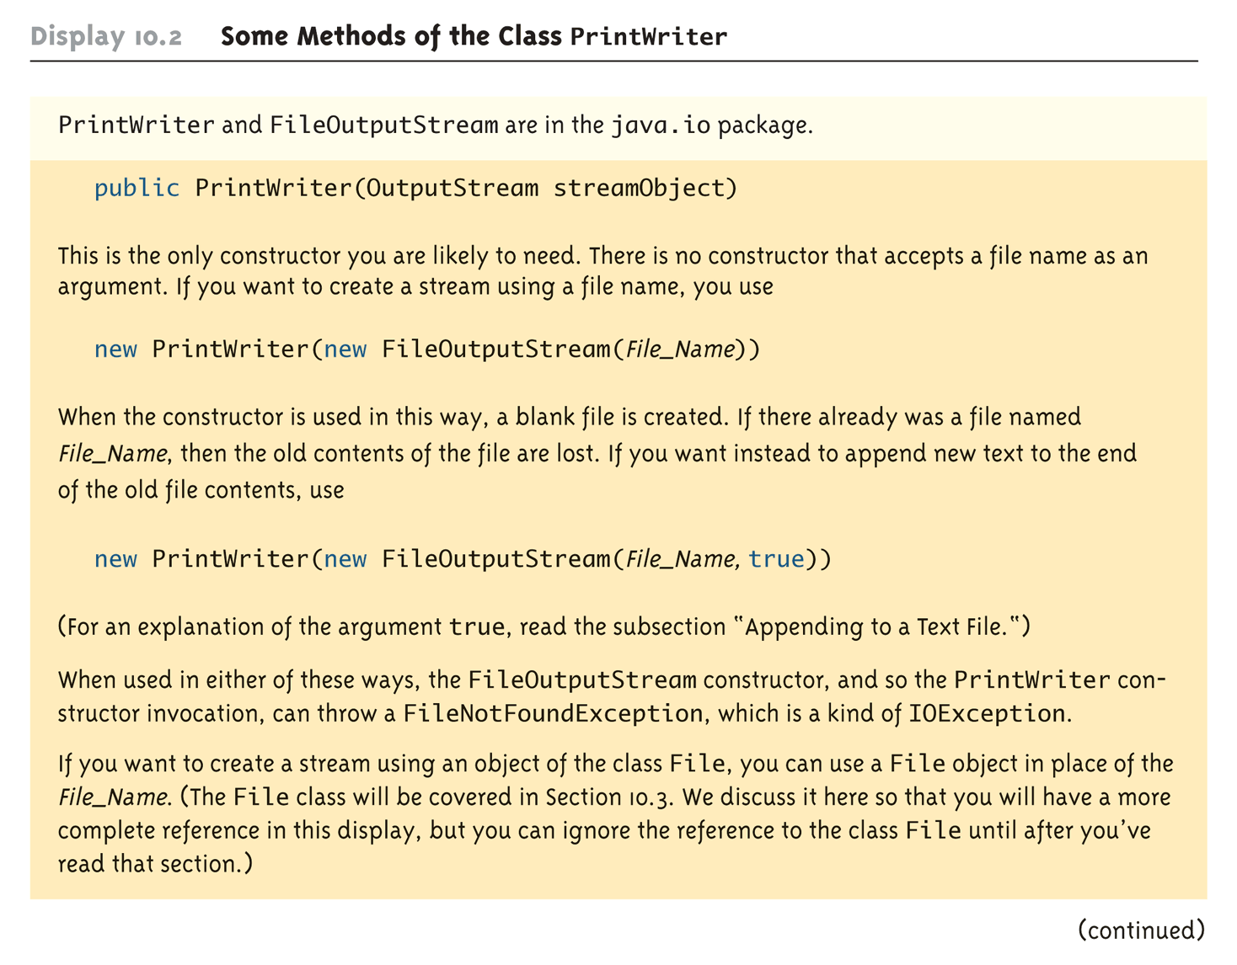
Some Methods of the Class PrintWriter (Part 1 of 3)

Slide 22
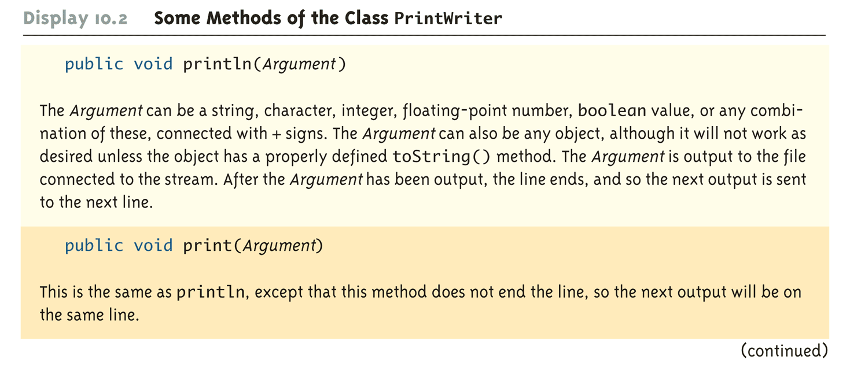
Some Methods of the Class PrintWriter (Part 2 of 3)

Slide 23
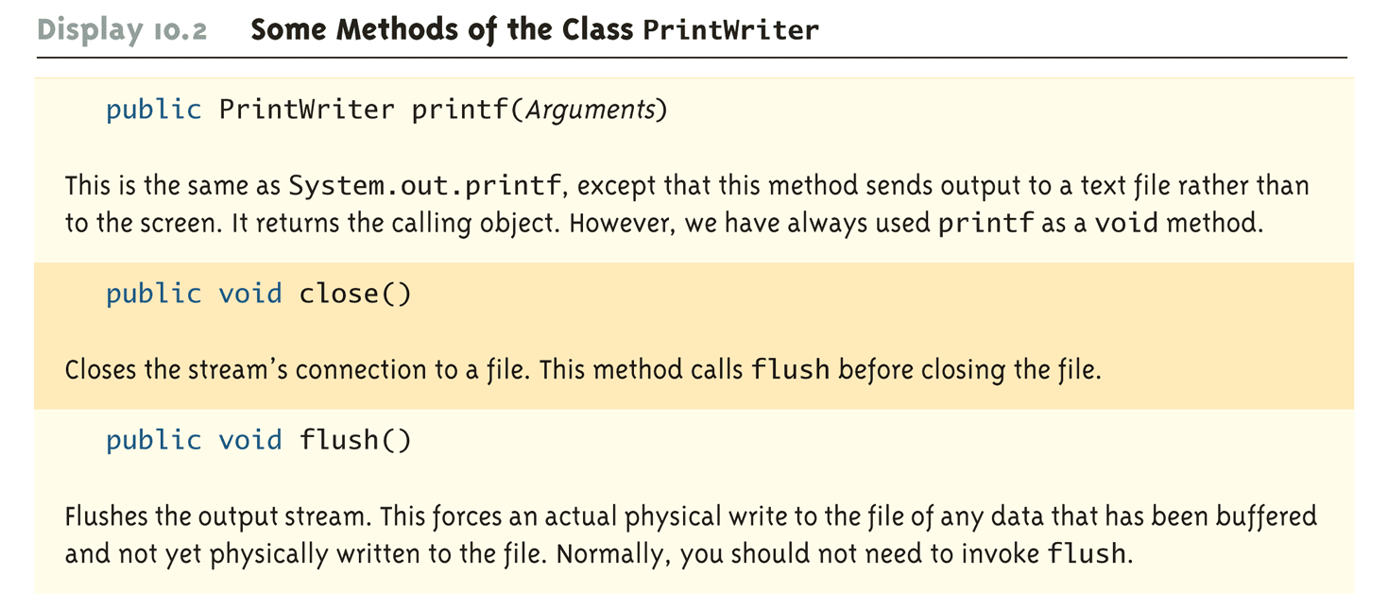
Some Methods of the Class PrintWriter (Part 3 of 3)

Slide 24
Reading From a Text File Using Scanner
The class Scanner can be used for reading from the keyboard as well as reading from a text file
Simply replace the argument System.in (to the Scanner constructor) with a suitable stream that is connected to the text file
Scanner StreamObject =
new Scanner(new FileInputStream(FileName));
Methods of the Scanner class for reading input behave the same whether reading from the keyboard or reading from a text file
For example, the nextInt and nextLine methods

Slide 25
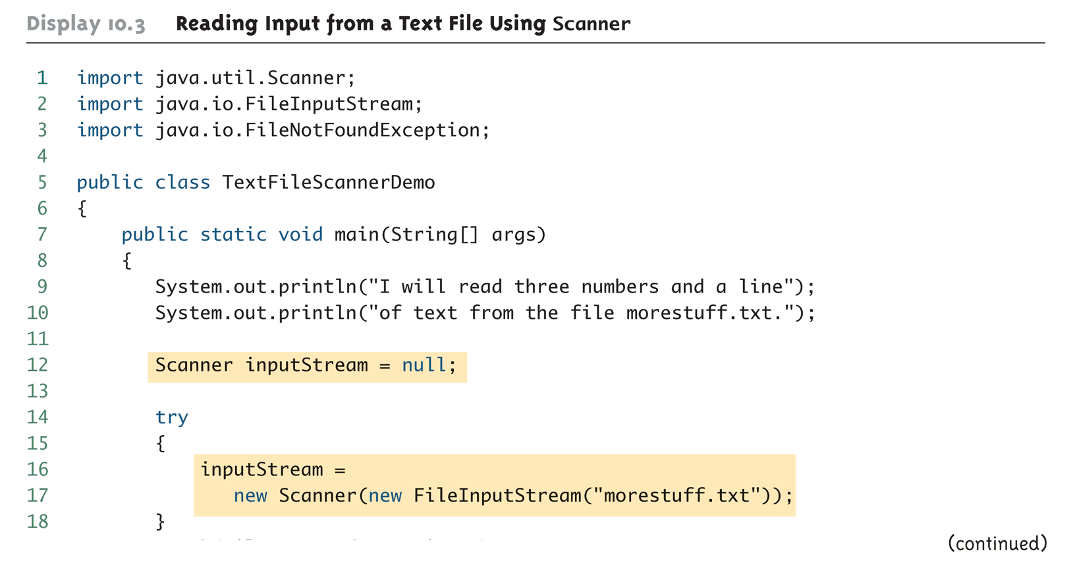
Reading Input from a Text File Using Scanner (Part 1 of 4)

Slide 26
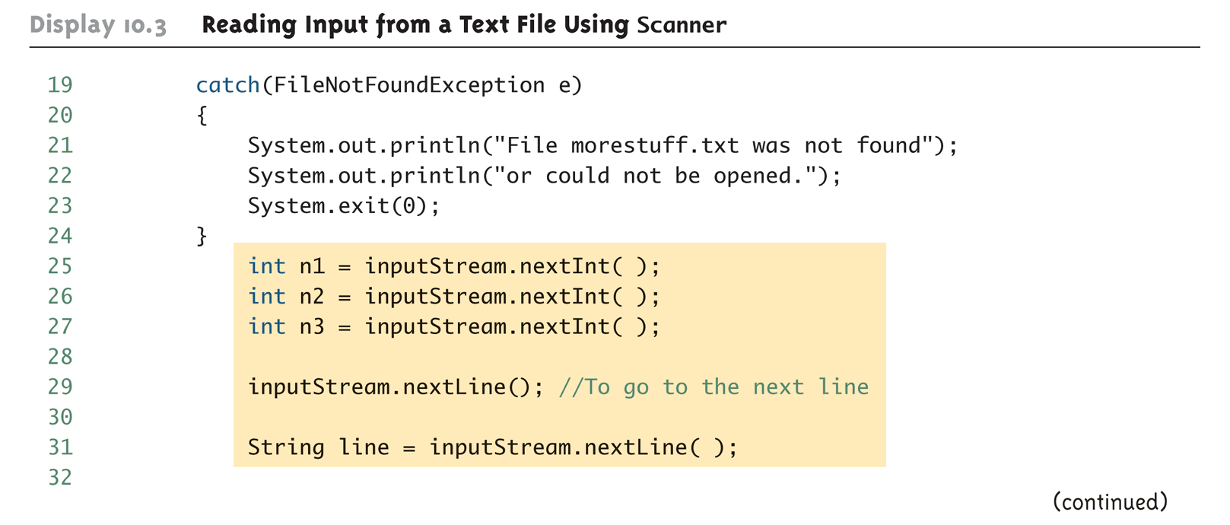
Reading Input from a Text File Using Scanner (Part 2 of 4)

Slide 27
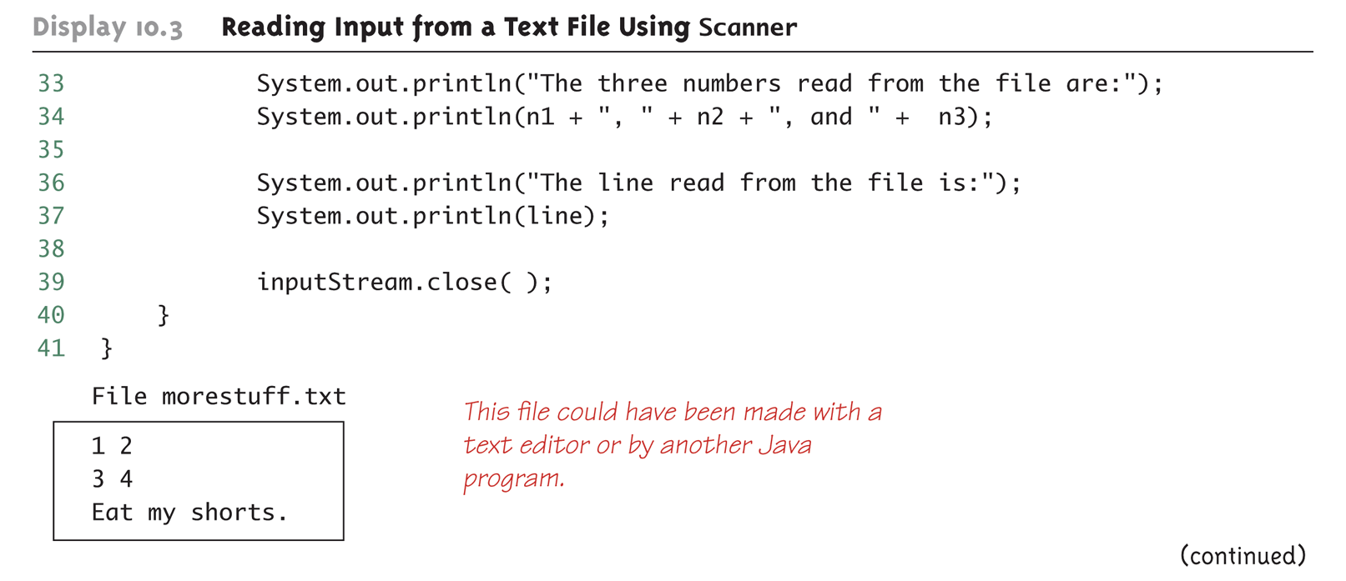
Reading Input from a Text File Using Scanner (Part 3 of 4)

Slide 28
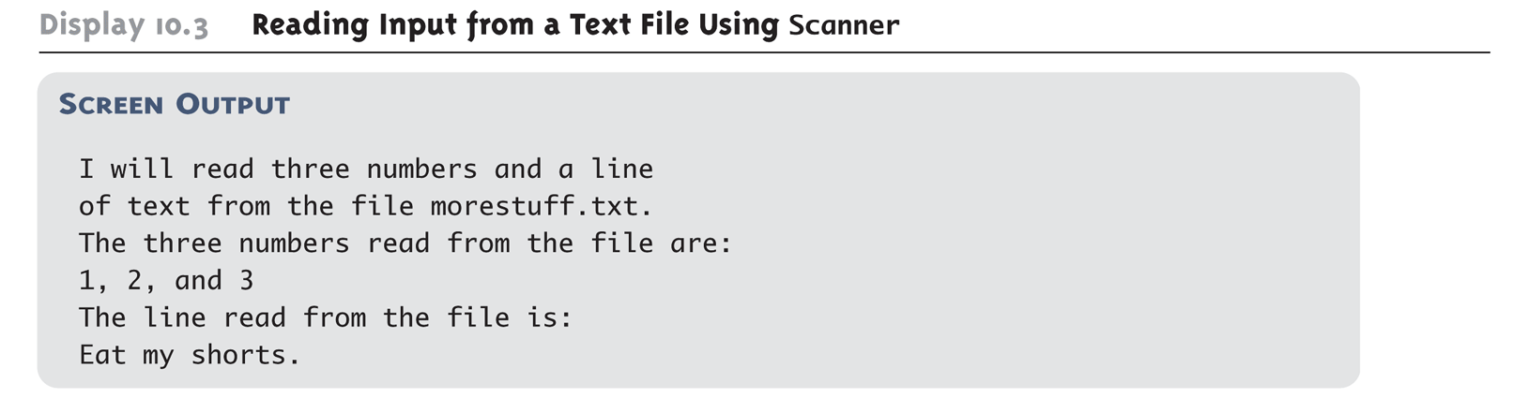
Reading Input from a Text File Using Scanner (Part 4 of 4)

Slide 29
Testing for the End of a Text File with Scanner
A program that tries to read beyond the end of a file using methods of the Scanner class will cause an exception to be thrown
However, instead of having to rely on an exception to signal the end of a file, the Scanner class provides methods such as hasNextInt and hasNextLine
These methods can also be used to check that the next token to be input is a suitable element of the appropriate type

Slide 30
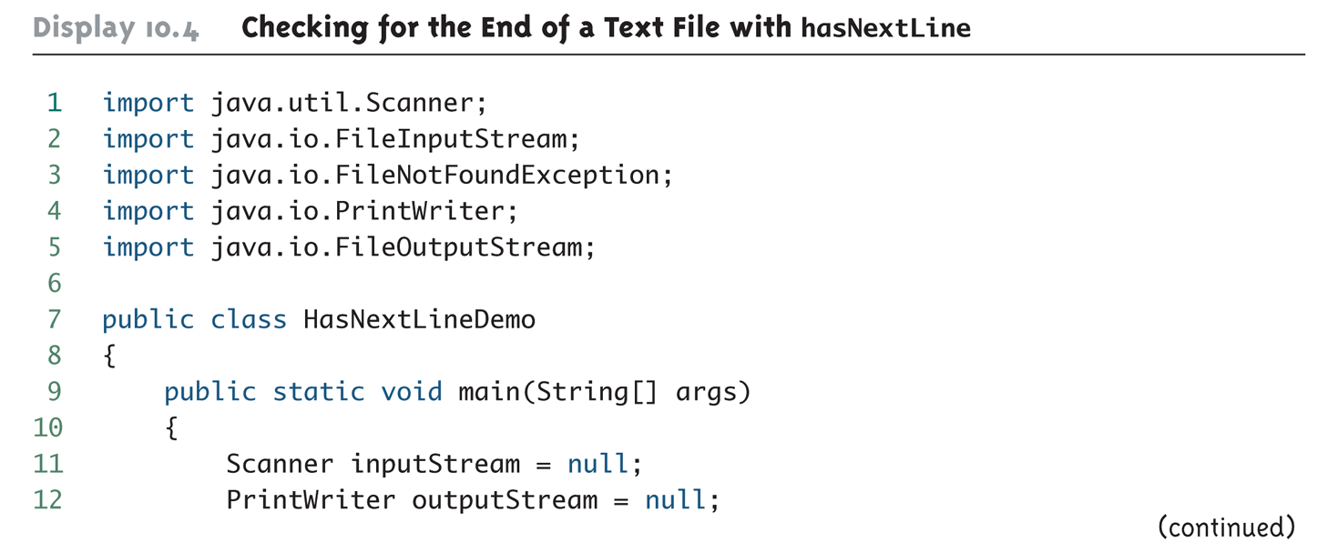
Checking for the End of a Text File with hasNextLine (Part 1 of 4)

Slide 31
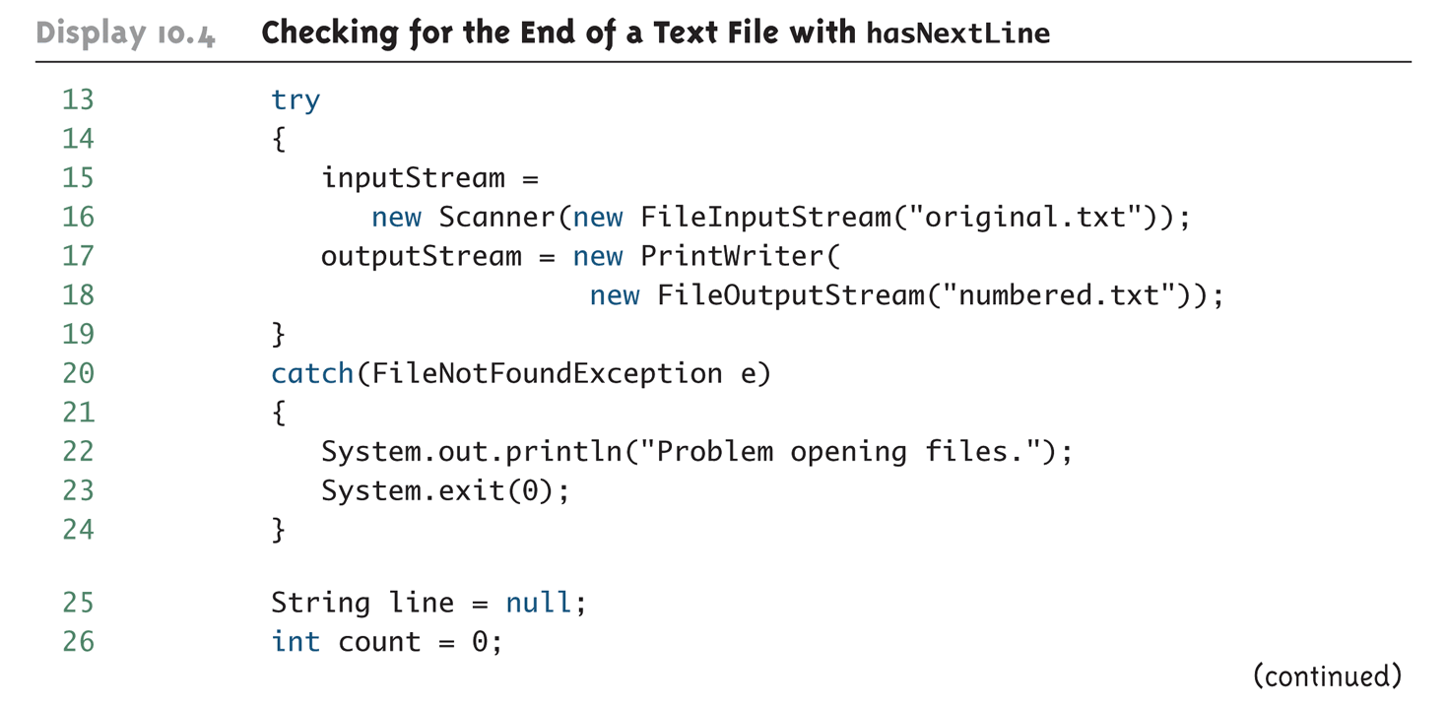
Checking for the End of a Text File with hasNextLine (Part 2 of 4)

Slide 32
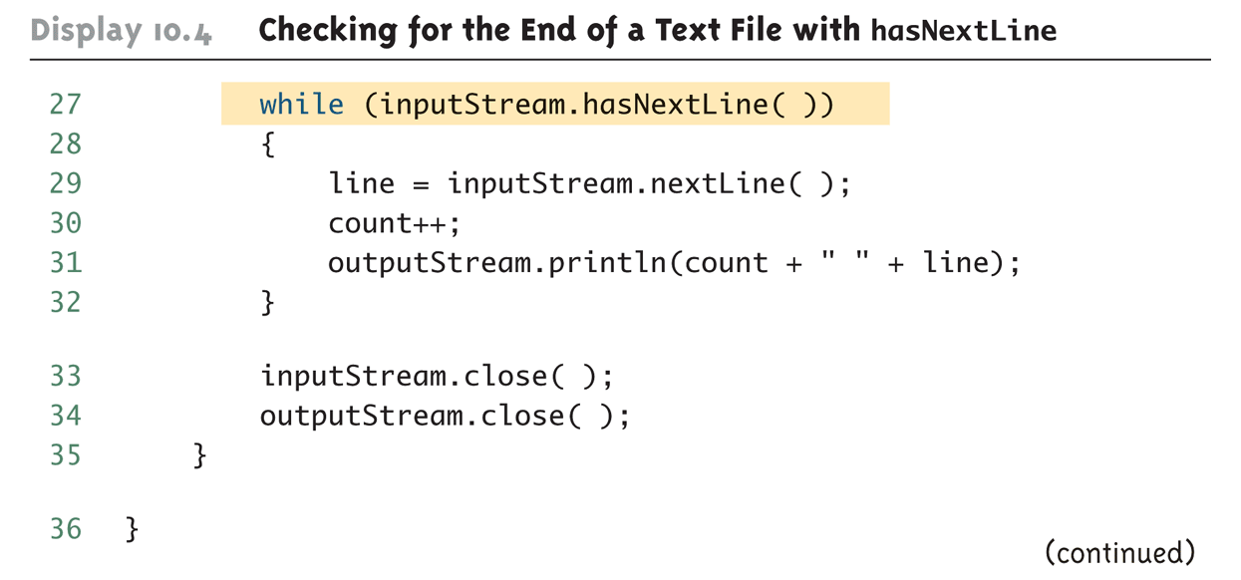
Checking for the End of a Text File with hasNextLine (Part 3 of 4)

Slide 33
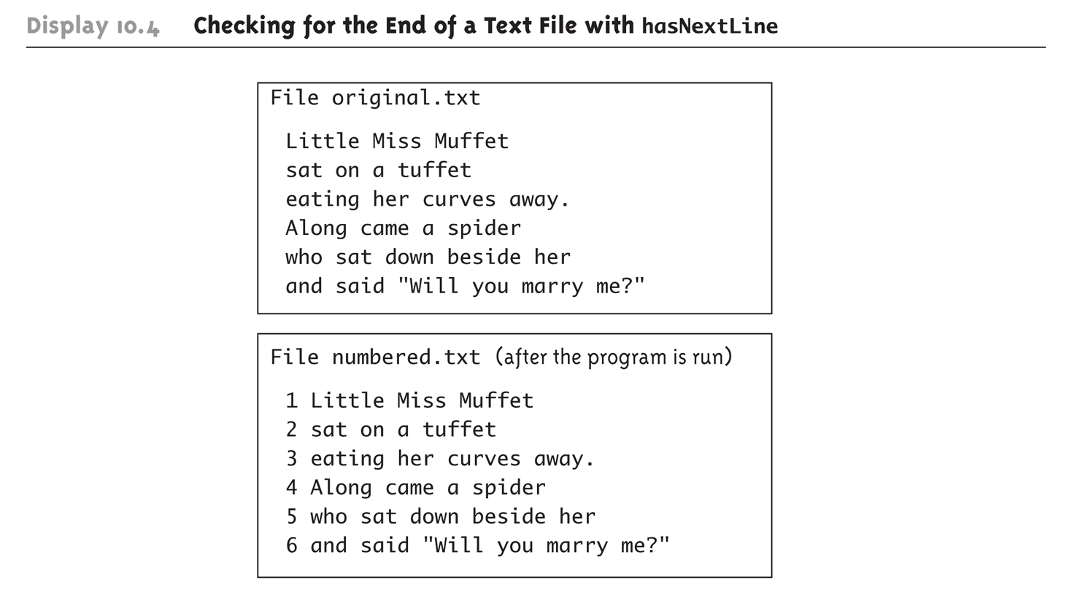
Checking for the End of a Text File with hasNextLine (Part 4 of 4)

Slide 34
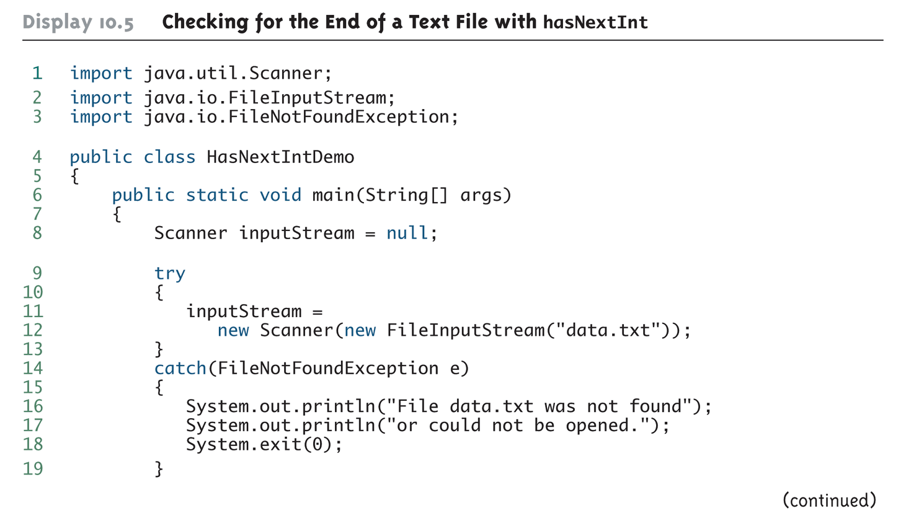
Checking for the End of a Text File with hasNextInt (Part 1 of 2)

Slide 35
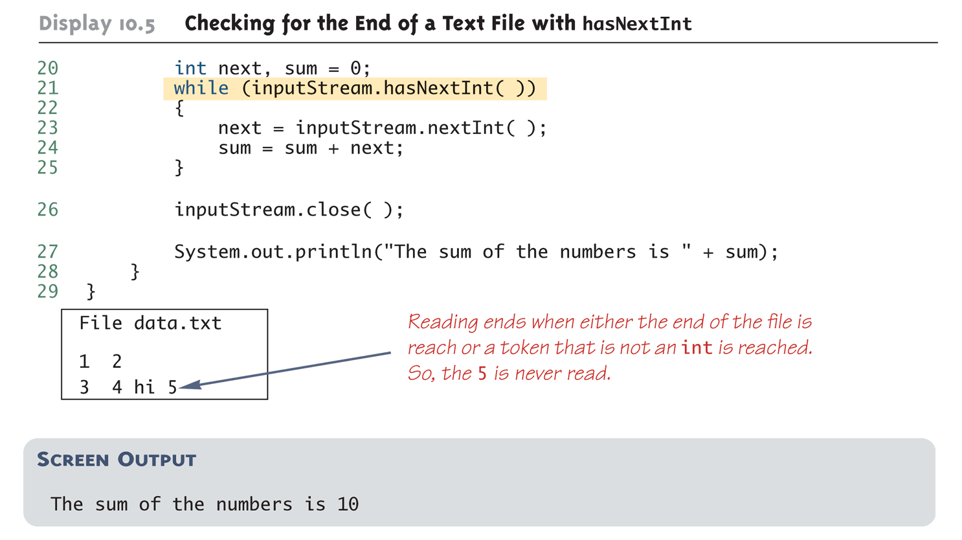
Checking for the End of a Text File with hasNextInt (Part 2 of 2)

Slide 36
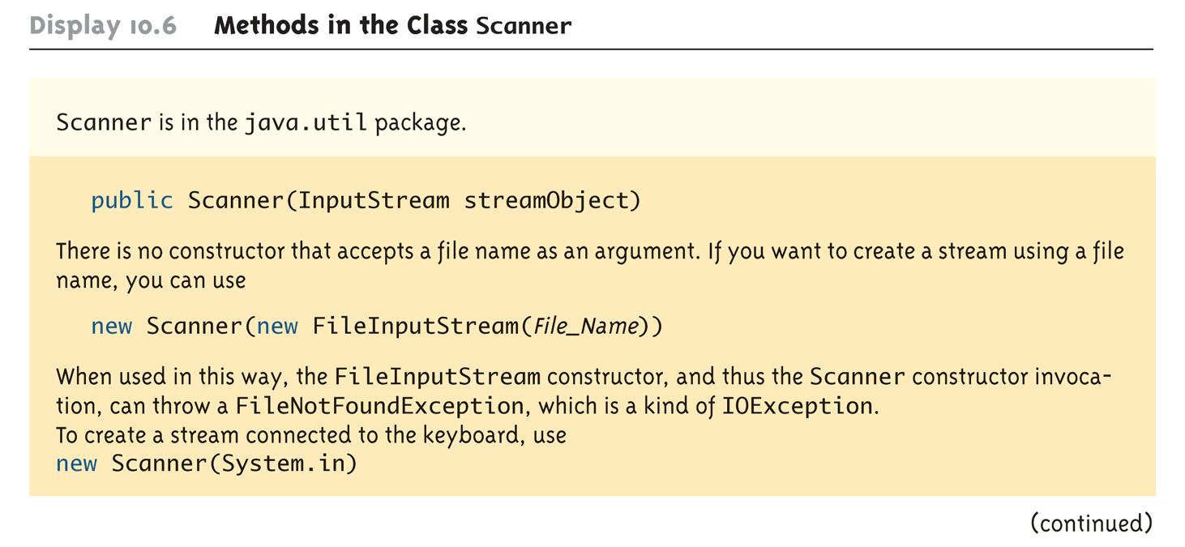
Methods in the Class Scanner (Part 1 of 11)

Slide 37
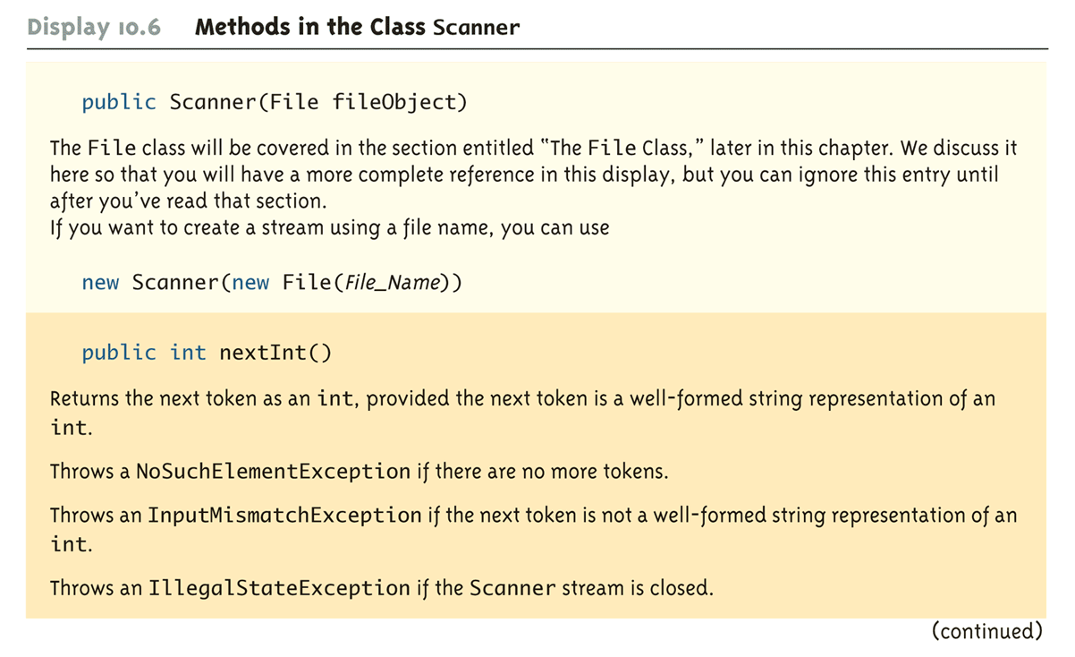
Methods in the Class Scanner (Part 2 of 11)

Slide 38
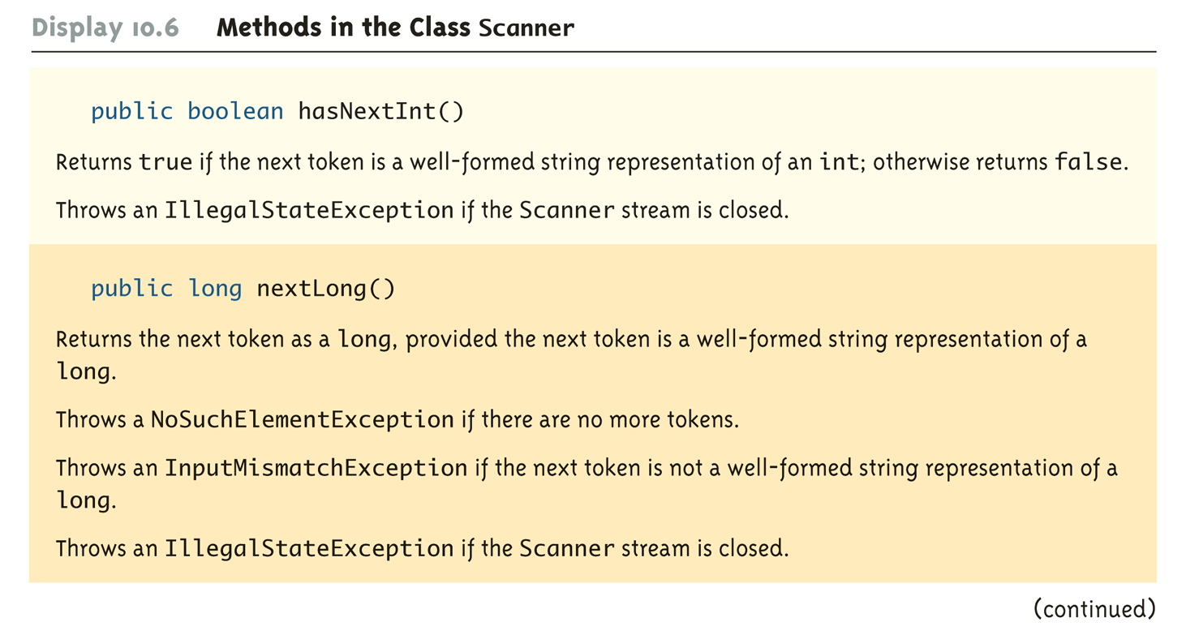
Methods in the Class Scanner (Part 3 of 11)

Slide 39
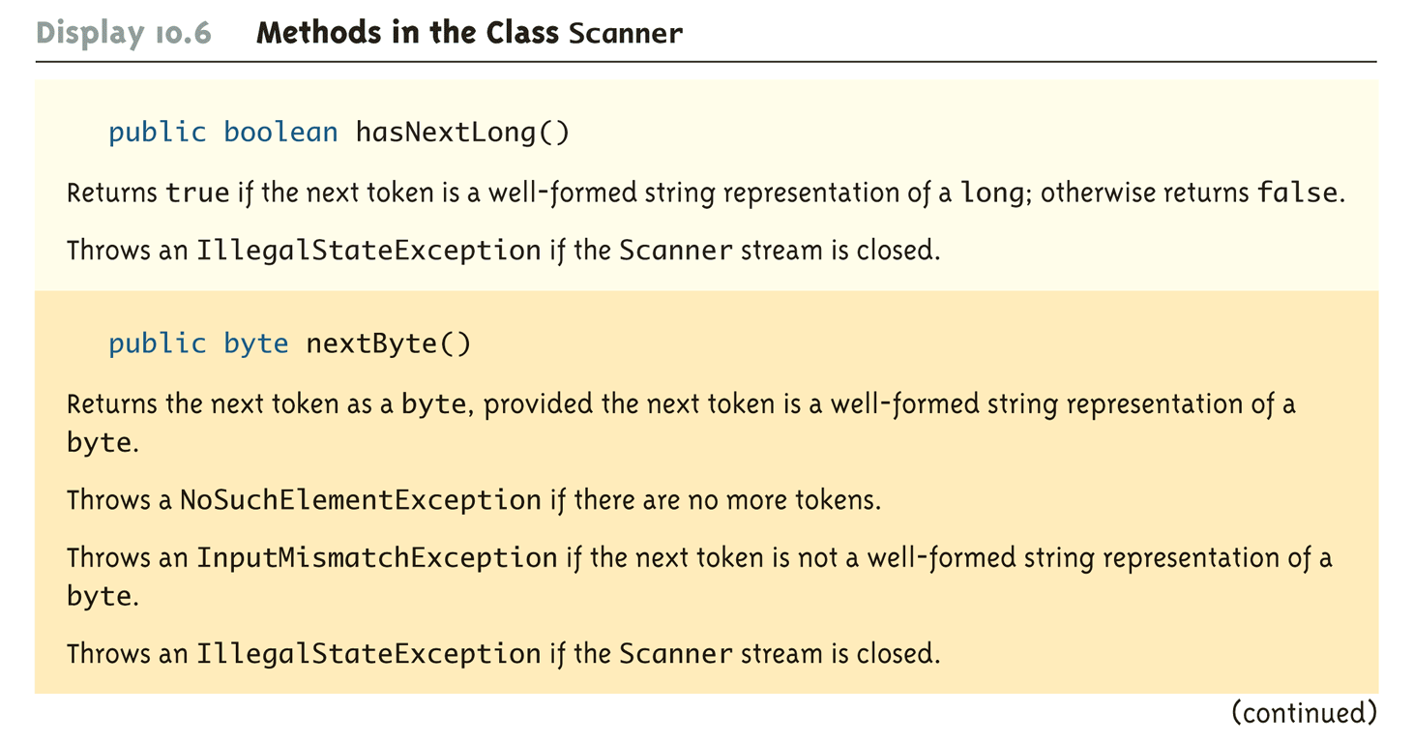
Methods in the Class Scanner (Part 4 of 11)

Slide 40
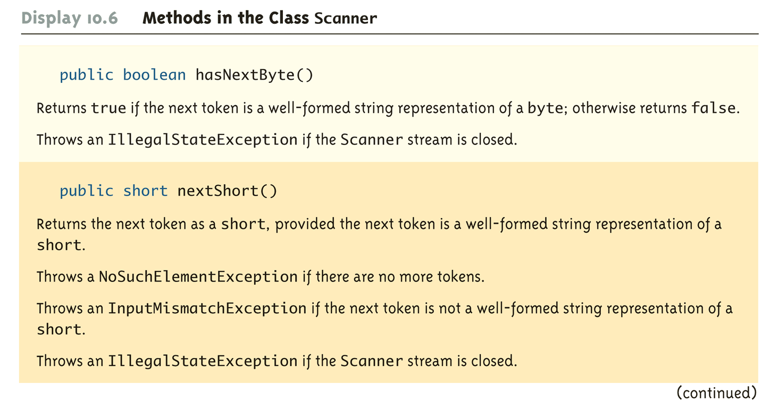
Methods in the Class Scanner (Part 5 of 11)

Slide 41
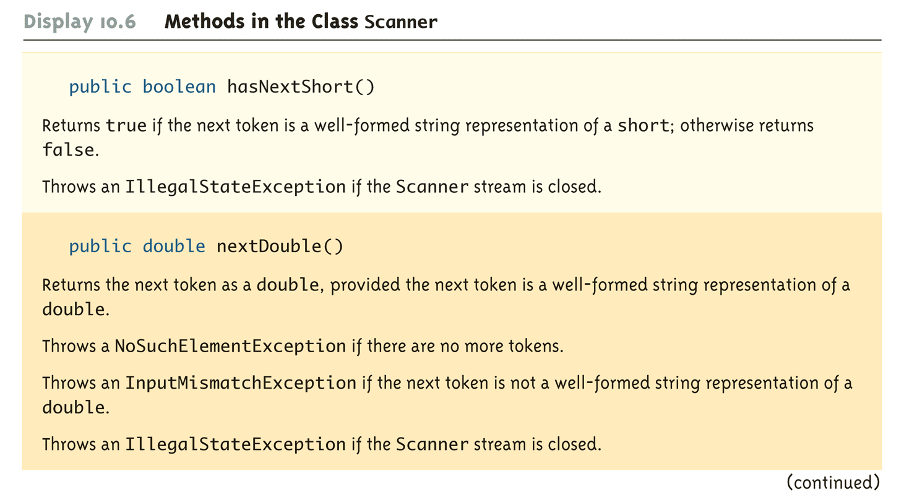
Methods in the Class Scanner (Part 6 of 11)

Slide 42
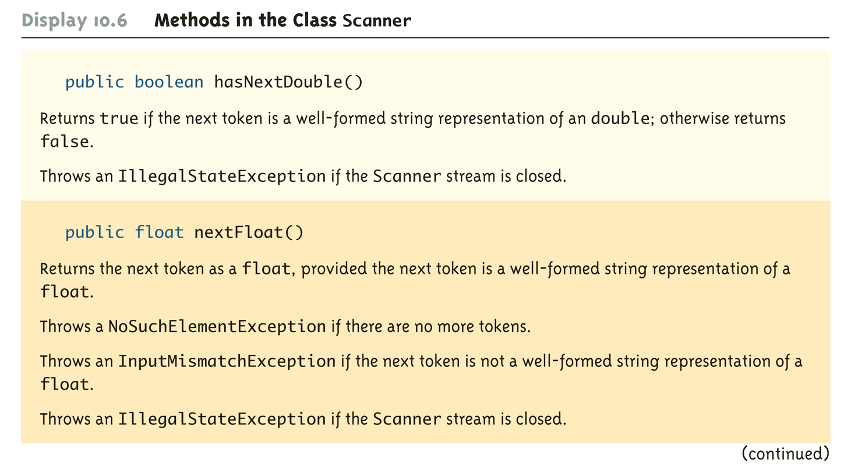
Methods in the Class Scanner (Part 7 of 11)

Slide 43
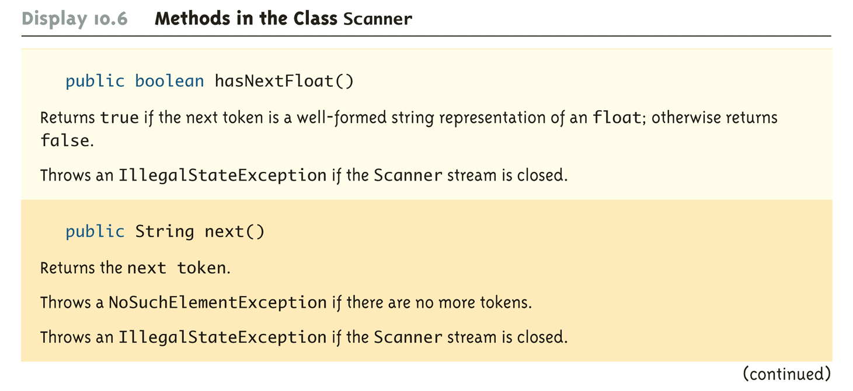
Methods in the Class Scanner (Part 8 of 11)

Slide 44
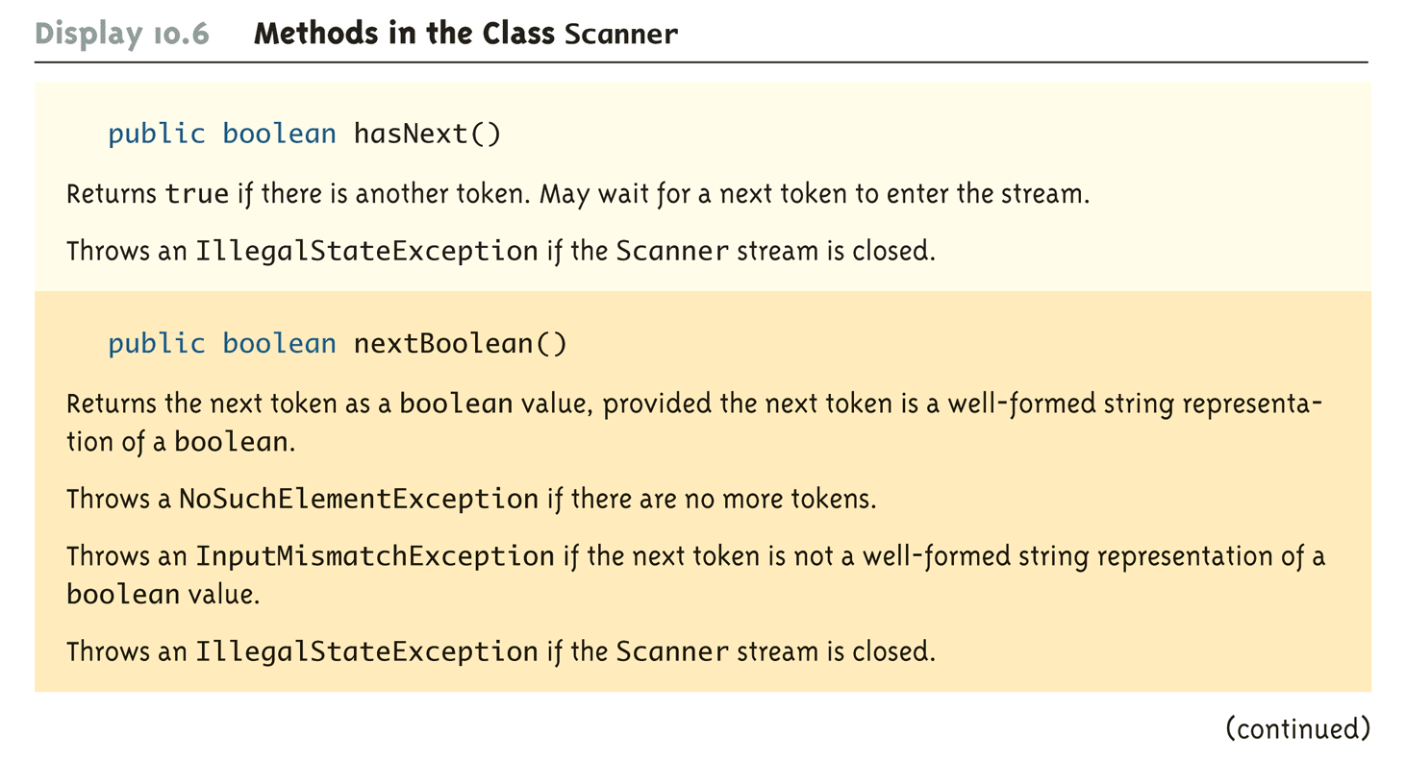
Methods in the Class Scanner (Part 9 of 11)

Slide 45
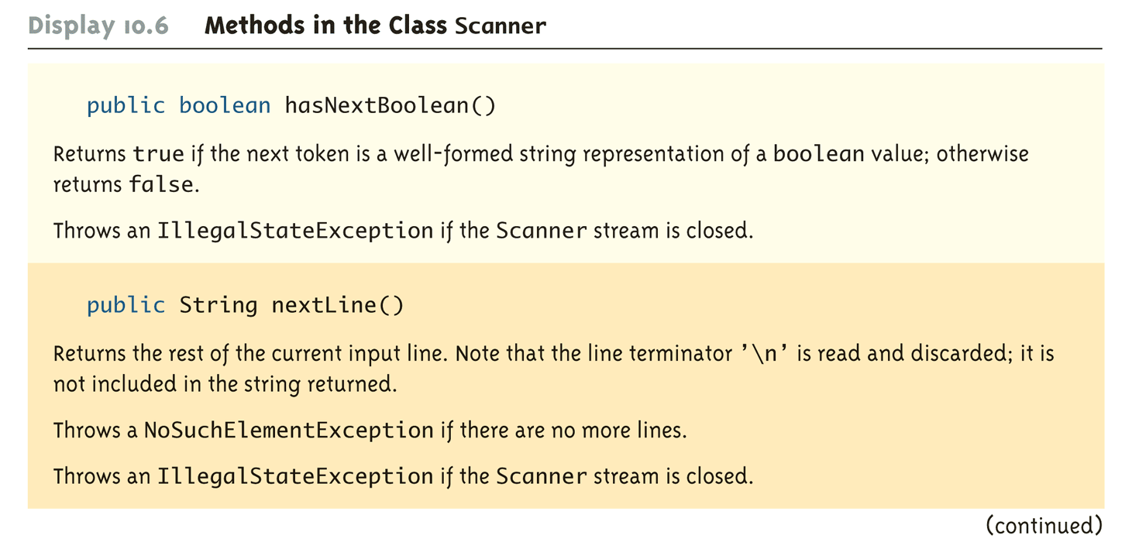
Methods in the Class Scanner (Part 10 of 11)

Slide 46
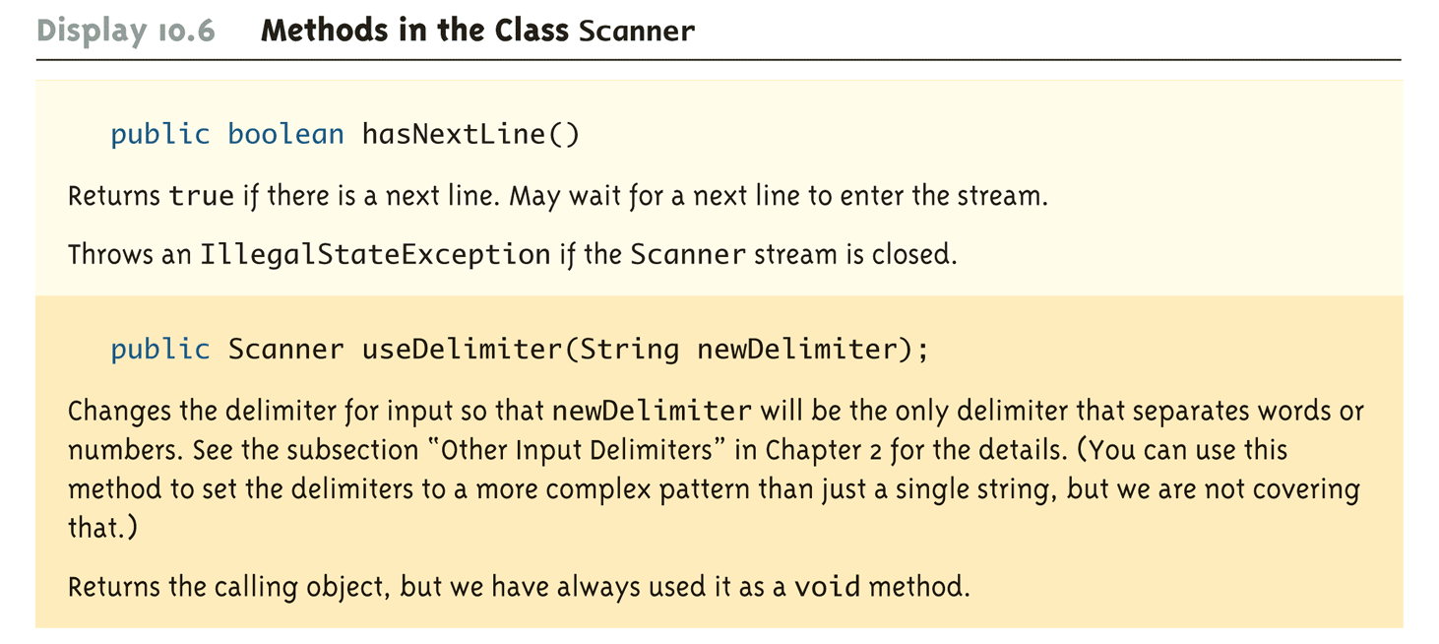
Methods in the Class Scanner (Part 11 of 11)

Slide 47
Reading From a Text File Using BufferedReader
The class BufferedReader is a stream class that can be used to read from a text file
An object of the class BufferedReader has the methods read and readLine
A program using BufferedReader, like one using PrintWriter, will start with a set of import statements:
import java.io.BufferedReader;
import java.io.FileReader;
import java.io.FileNotFoundException;
import java.io.IOException;

Slide 48
Reading From a Text File Using BufferedReader
Like the classes PrintWriter and Scanner, BufferedReader has no constructor that takes a file name as its argument
It needs to use another class, FileReader, to convert the file name to an object that can be used as an argument to its (the BufferedReader) constructor
A stream of the class BufferedReader is created and connected to a text file as follows:
BufferedReader readerObject;
readerObject = new BufferedReader(new
FileReader(FileName));
This opens the file for reading

Slide 49
Reading From a Text File
After these statements, the methods read and readLIne can be used to read from the file
The readLine method is the same method used to read from the keyboard, but in this case it would read from a file
The read method reads a single character, and returns a value (of type int) that corresponds to the character read
Since the read method does not return the character itself, a type cast must be used:
char next = (char)(readerObject.read());

Slide 50
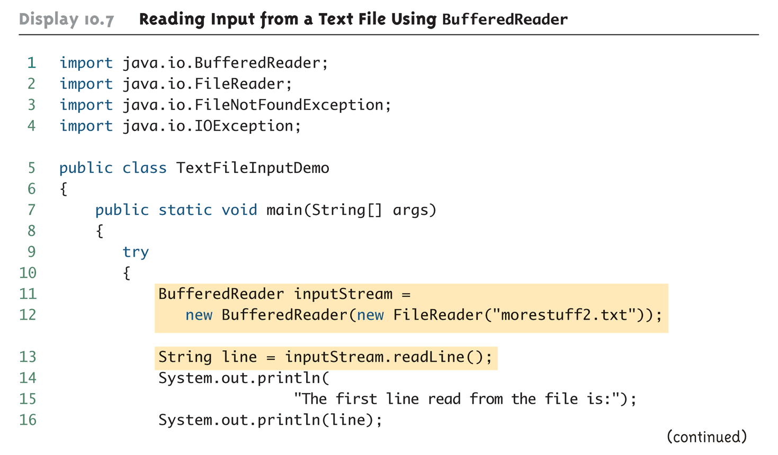
Reading Input from a Text File Using BufferedReader (Part 1 of 3)

Slide 51
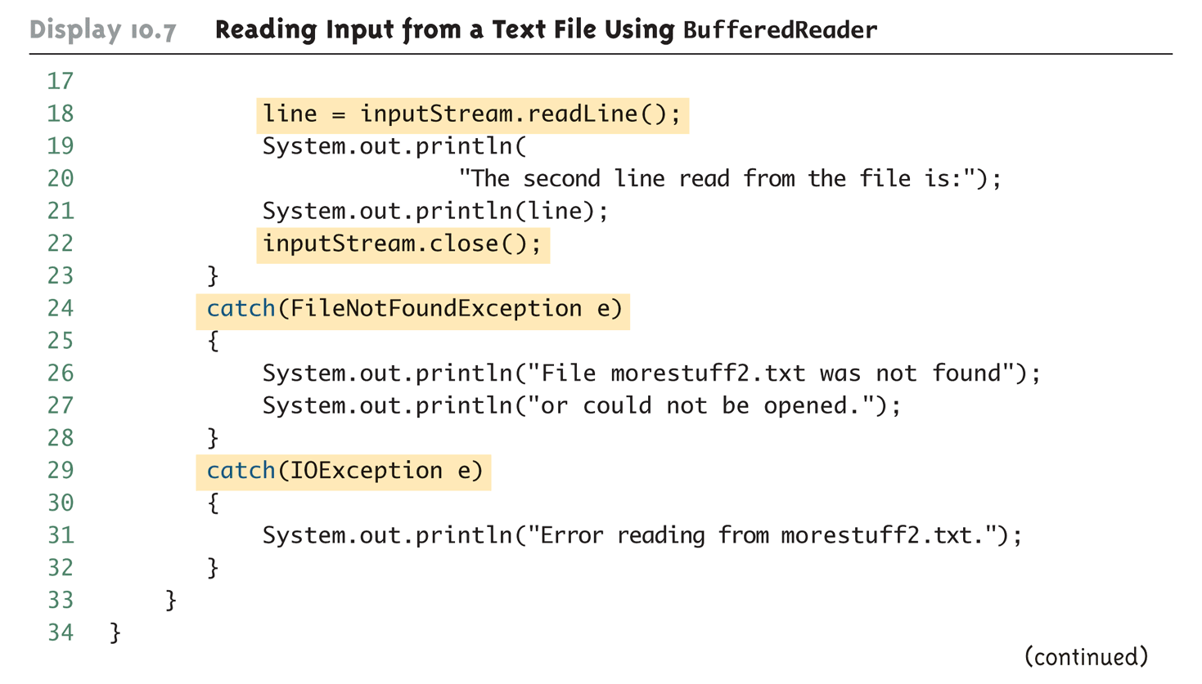
Reading Input from a Text File Using BufferedReader (Part 2 of 3)

Slide 52
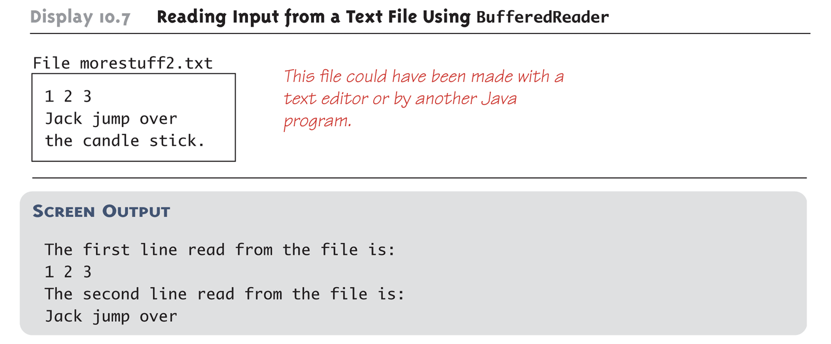
Reading Input from a Text File Using BufferedReader (Part 3 of 3)

Slide 53
Reading From a Text File
A program using a BufferedReader object in this way may throw two kinds of exceptions
An attempt to open the file may throw a FileNotFoundException (which in this case has the expected meaning)
An invocation of readLine may throw an IOException
Both of these exceptions should be handled

Slide 54
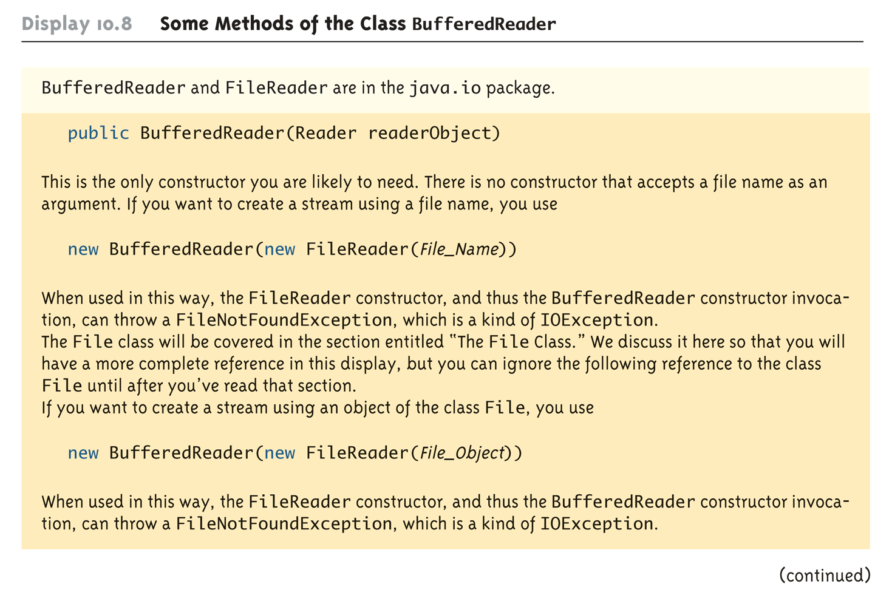
Some Methods of the Class BufferedReader (Part 1 of 2)

Slide 55
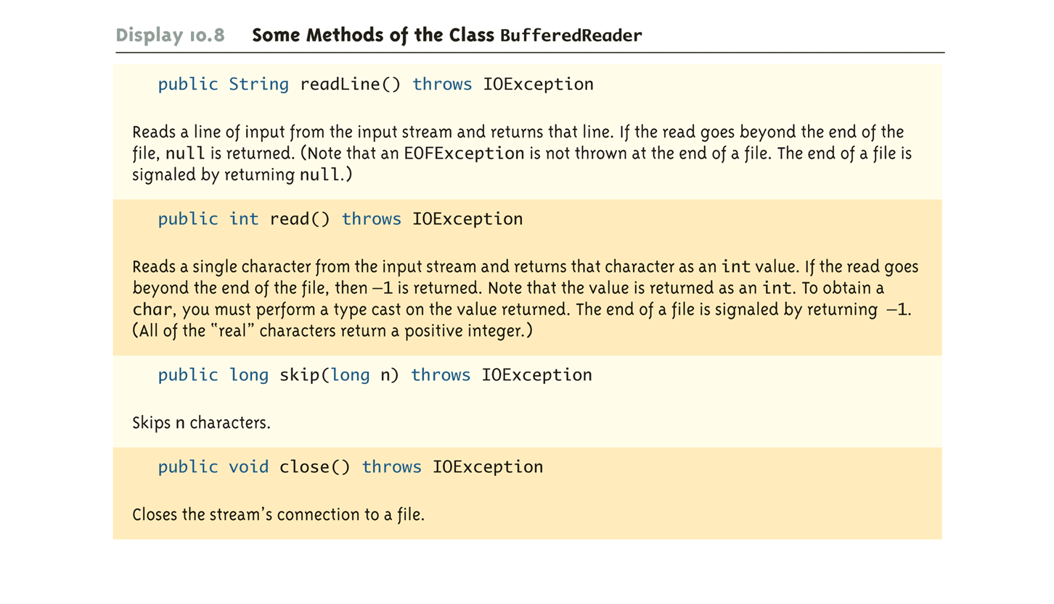
Some Methods of the Class BufferedReader (Part 2 of 2)

Slide 56
Reading Numbers
Unlike the Scanner class, the class BufferedReader has no methods to read a number from a text file
Instead, a number must be read in as a string, and then converted to a value of the appropriate numeric type using one of the wrapper classes
To read in a single number on a line by itself, first use the method readLine, and then use Integer.parseInt, Double.parseDouble, etc. to convert the string into a number
If there are multiple numbers on a line, StringTokenizer can be used to decompose the string into tokens, and then the tokens can be converted as described above
Scanner클래스와 달리
bufferedReader는 numbe를 읽는 메소드가 없어서
문장을 읽고 변환해줘야한다

Slide 57
Testing for the End of a Text File
The method readLine of the class BufferedReader returns null when it tries to read beyond the end of a text file
A program can test for the end of the file by testing for the value null when using readLine
The method read of the class BufferedReader returns -1 when it tries to read beyond the end of a text file
A program can test for the end of the file by testing for the value -1 when using read
마지막 -1

Slide 58
Path Names
When a file name is used as an argument to a constructor for opening a file, it is assumed that the file is in the same directory or folder as the one in which the program is run
If it is not in the same directory, the full or relative path name must be given

Slide 59
Path Names
A path name not only gives the name of the file, but also the directory or folder in which the file exists
A full path name gives a complete path name, starting from the root directory
A relative path name gives the path to the file, starting with the directory in which the program is located

Slide 60
Path Names
The way path names are specified depends on the operating system
A typical UNIX path name that could be used as a file name argument is
"/user/sallyz/data/data.txt"
A BufferedReader input stream connected to this file is created as follows:
BufferedReader inputStream =
new BufferedReader(new
FileReader("/user/sallyz/data/data.txt"));

Slide 61
Path Names
The Windows operating system specifies path names in a different way
A typical Windows path name is the following:
C:\dataFiles\goodData\data.txt
A BufferedReader input stream connected to this file is created as follows:
BufferedReader inputStream = new
BufferedReader(new FileReader
("C:\\dataFiles\\goodData\\data.txt"));
Note that in Windows \\ must be used in place of \, since a single backslash denotes an the beginning of an escape sequence

Slide 62
Path Names
A double backslash (\\) must be used for a Windows path name enclosed in a quoted string
This problem does not occur with path names read in from the keyboard
Problems with escape characters can be avoided altogether by always using UNIX conventions when writing a path name
A Java program will accept a path name written in either Windows or Unix format regardless of the operating system on which it is run

Slide 63
Nested Constructor Invocations
Each of the Java I/O library classes serves only one function, or a small number of functions
Normally two or more class constructors are combined to obtain full functionality
Therefore, expressions with two constructors are common when dealing with Java I/O classes

Slide 64
Nested Constructor Invocations
new BufferedReader(new FileReader("stuff.txt"))
Above, the anonymous FileReader object establishes a connection with the stuff.txt file
However, it provides only very primitive methods for input
The constructor for BufferedReader takes this FileReader object and adds a richer collection of input methods
This transforms the inner object into an instance variable of the outer object

Slide 65
System.in, System.out, and System.err
The standard streams System.in, System.out, and System.err are automatically available to every Java program
System.out is used for normal screen output
System.err is used to output error messages to the screen
The System class provides three methods (setIn, setOut, and setErr) for redirecting these standard streams:
public static void setIn(InputStream inStream)
public static void setOut(PrintStream outStream)
public static void setErr(PrintStream outStream)

Slide 66
System.in, System.out, and System.err
Using these methods, any of the three standard streams can be redirected
For example, instead of appearing on the screen, error messages could be redirected to a file
In order to redirect a standard stream, a new stream object is created
Like other streams created in a program, a stream object used for redirection must be closed after I/O is finished
Note, standard streams do not need to be closed

Slide 67
System.in, System.out, and System.err
Redirecting System.err:
public void getInput()
{
. . .
PrintStream errStream = null;
try
{
errStream = new PrintStream(new
FileOuptputStream("errMessages.txt"));
System.setErr(errStream);
. . . //Set up input stream and read
}

Slide 68
System.in, System.out, and System.err
catch(FileNotFoundException e)
{
System.err.println("Input file not found");
}
finally
{
. . .
errStream.close();
}
}

Slide 69
The File Class
The File class is like a wrapper class for file names
The constructor for the class File takes a name, (known as the abstract name) as a string argument, and produces an object that represents the file with that name
The File object and methods of the class File can be used to determine information about the file and its properties

Slide 70
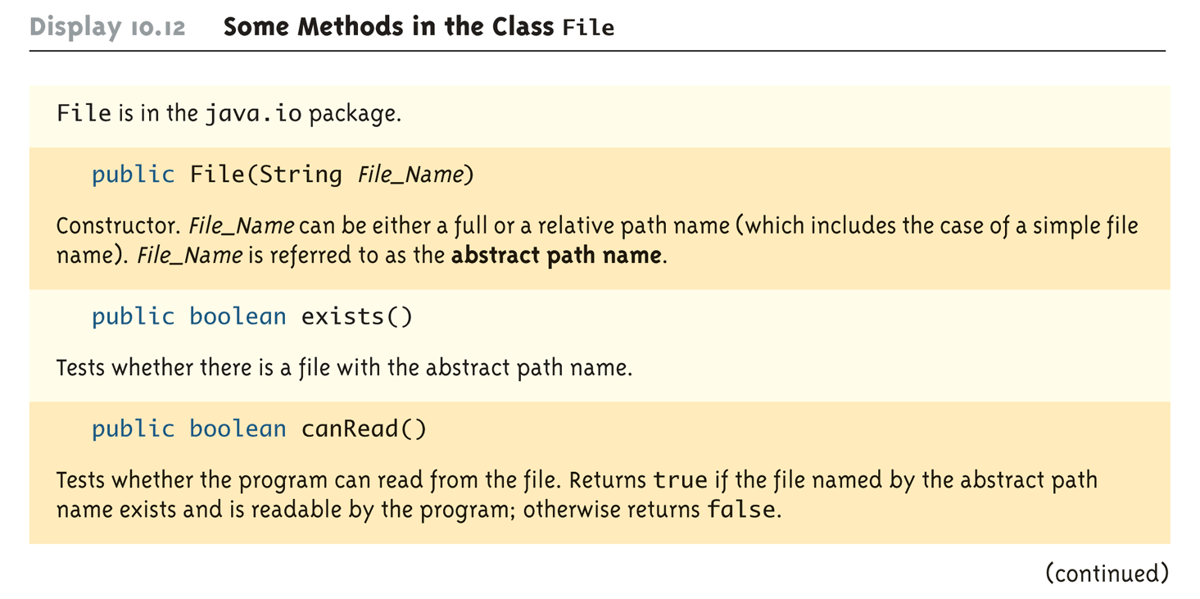
Some Methods in the Class File (Part 1 of 5)

Slide 71
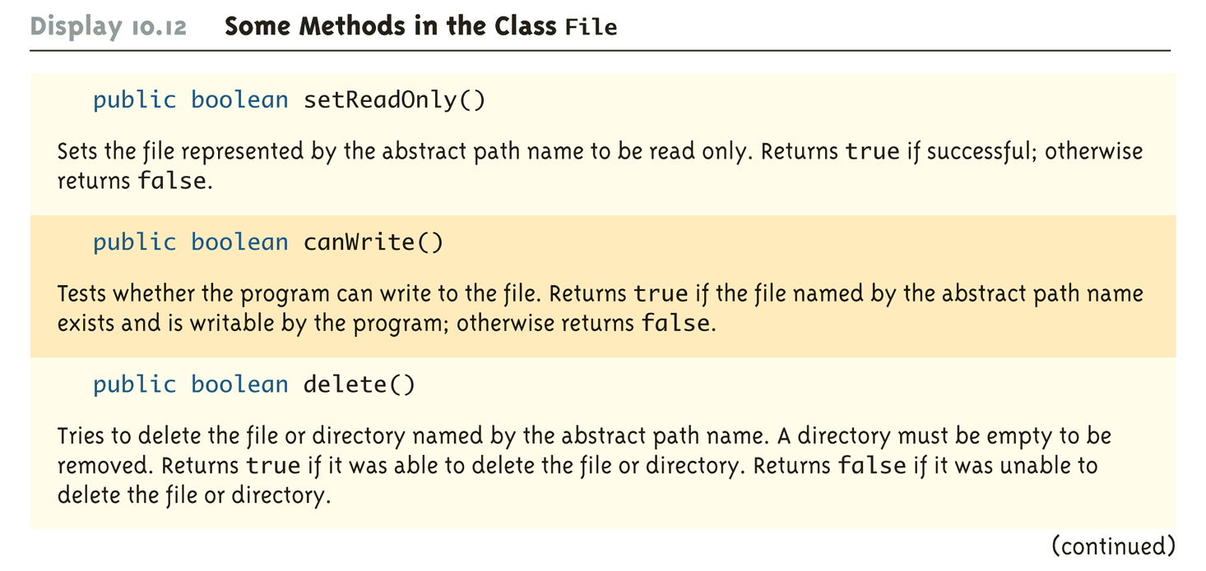
Some Methods in the Class File (Part 2 of 5)

Slide 72
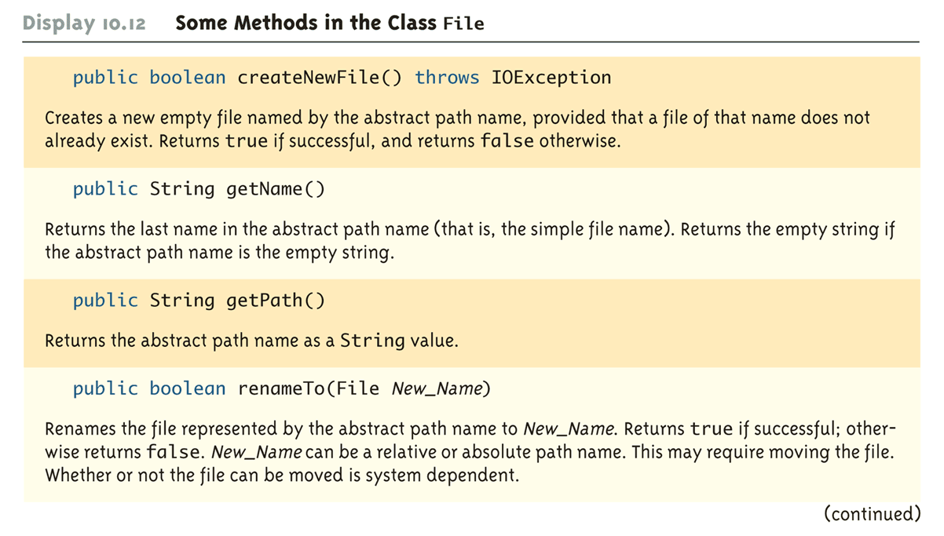
Some Methods in the Class File (Part 3 of 5)

Slide 73
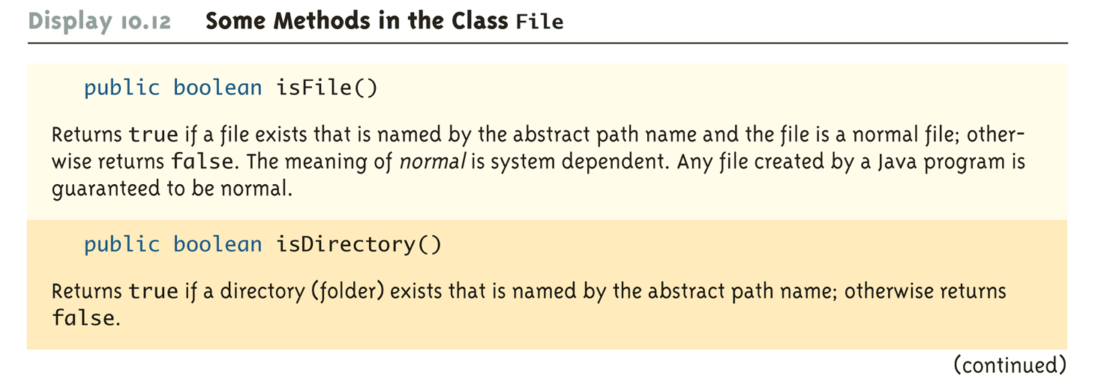
Some Methods in the Class File (Part 4 of 5)

Slide 74
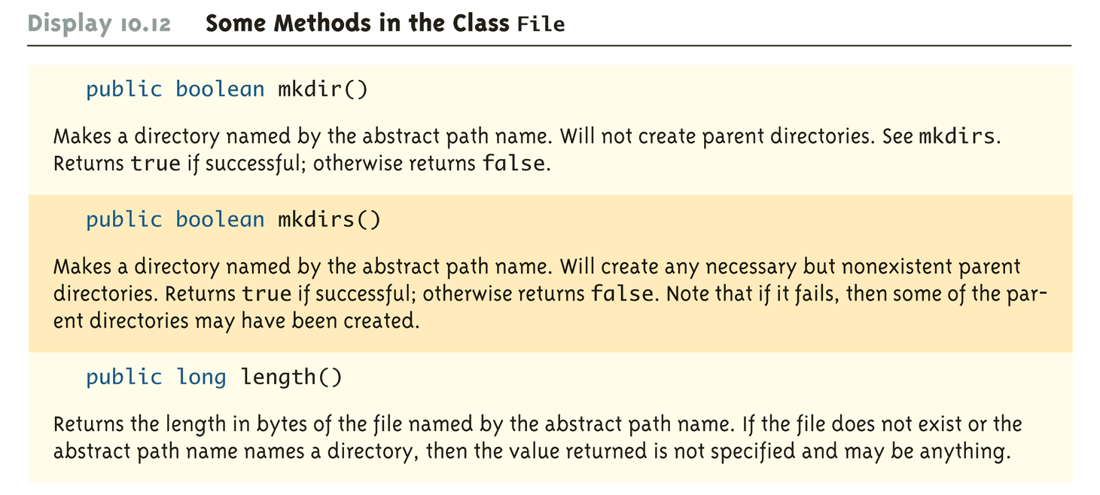
Some Methods in the Class File (Part 5 of 5)

Slide 75
Binary Files
Binary files store data in the same format used by computer memory to store the values of variables
No conversion needs to be performed when a value is stored or retrieved from a binary file
Java binary files, unlike other binary language files, are portable
A binary file created by a Java program can be moved from one computer to another
These files can then be read by a Java program, but only by a Java program

Slide 76
Writing Simple Data to a Binary File
The class ObjectOutputStream is a stream class that can be used to write to a binary file
An object of this class has methods to write strings, values of primitive types, and objects to a binary file
A program using ObjectOutputStream needs to import several classes from package java.io:
import java.io.ObjectOutputStream;
import java.io.FileOutStream;
import java.io.IOException;

Slide 77
Opening a Binary File for Output
An ObjectOutputStream object is created and connected to a binary file as follows:
ObjectOutputStream outputStreamName = new
ObjectOutputStream(new
FileOutputStream(FileName));
The constructor for FileOutputStream may throw a FileNotFoundException
The constructor for ObjectOutputStream may throw an IOException
Each of these must be handled

Slide 78
Opening a Binary File for Output
After opening the file, ObjectOutputStream methods can be used to write to the file
Methods used to output primitive values include writeInt, writeDouble, writeChar, and writeBoolean
UTF is an encoding scheme used to encode Unicode characters that favors the ASCII character set
The method writeUTF can be used to output values of type String
The stream should always be closed after writing

Slide 79
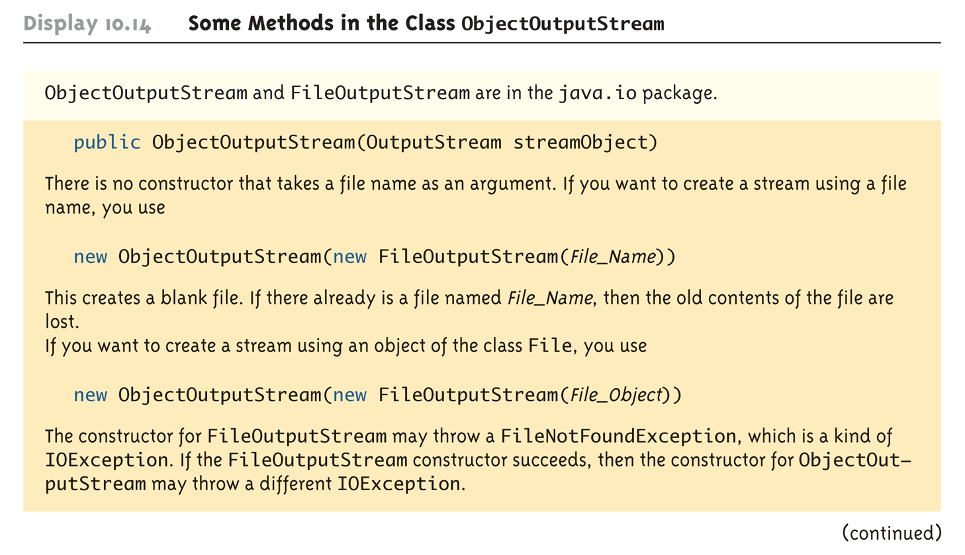
Some Methods in the Class ObjectOutputStream (Part 1 of 5)

Slide 80
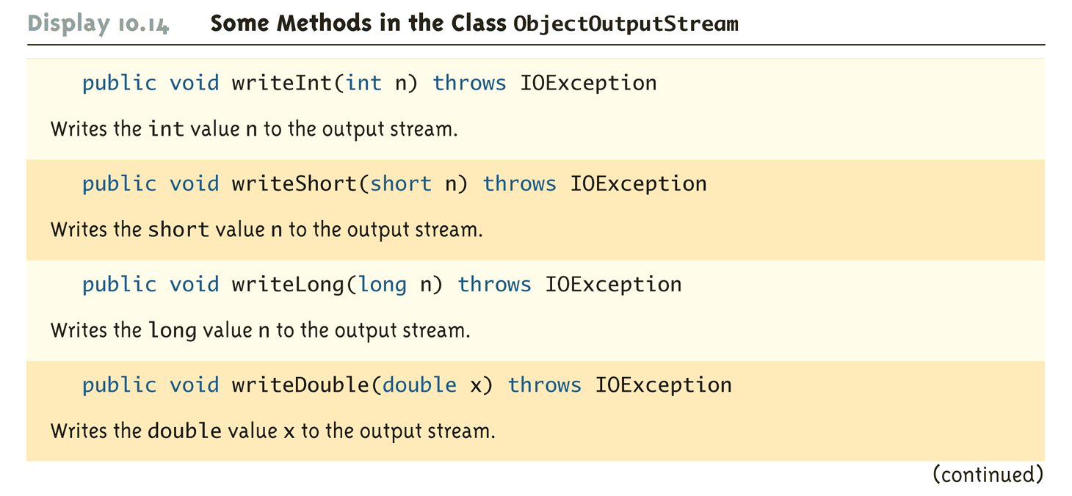
Some Methods in the Class ObjectOutputStream (Part 2 of 5)

Slide 81
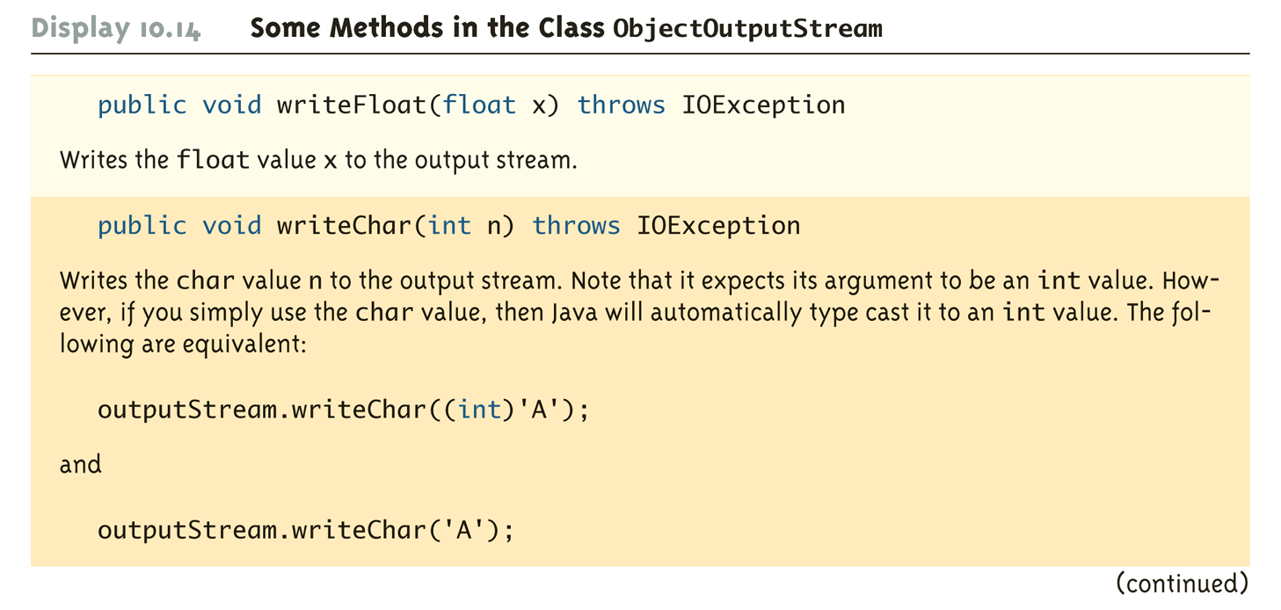
Some Methods in the Class ObjectOutputStream (Part 3 of 5)

Slide 82
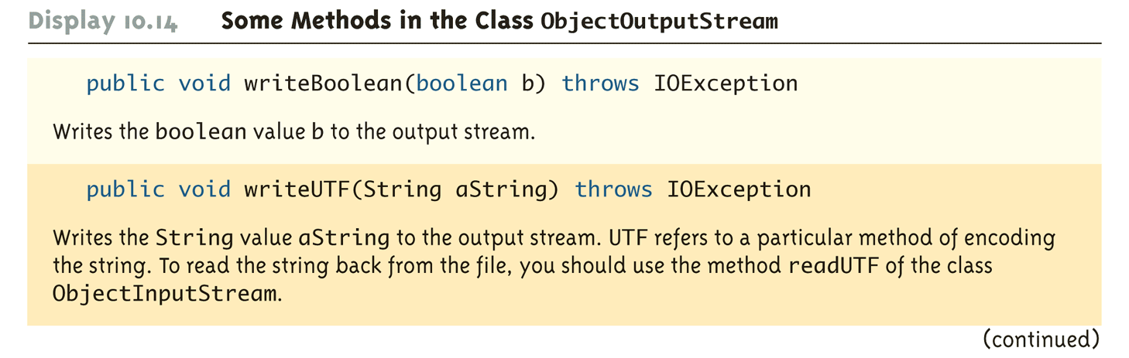
Some Methods in the Class ObjectOutputStream (Part 4 of 5)

Slide 83
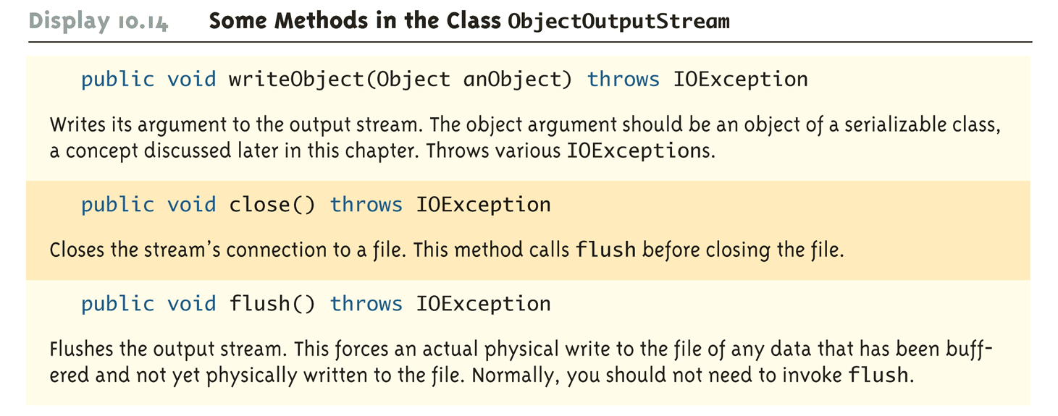
Some Methods in the Class ObjectOutputStream (Part 5 of 5)

Slide 84
Reading Simple Data from a Binary File
The class ObjectInputStream is a stream class that can be used to read from a binary file
An object of this class has methods to read strings, values of primitive types, and objects from a binary file
A program using ObjectInputStream needs to import several classes from package java.io:
import java.io.ObjectInputStream;
import java.io.FileInputStream;
import java.io.IOException;

Slide 85
Opening a Binary File for Reading
An ObjectInputStream object is created and connected to a binary file as follows:
ObjectInputStream inStreamName = new
ObjectInputStream(new
FileInputStream(FileName));
The constructor for FileInputStream may throw a FileNotFoundException
The constructor for ObjectInputStream may throw an IOException
Each of these must be handled

Slide 86
Opening a Binary File for Reading
After opening the file, ObjectInputStream methods can be used to read to the file
Methods used to input primitive values include readInt, readDouble, readChar, and readBoolean
The method readUTF is used to input values of type String
If the file contains multiple types, each item type must be read in exactly the same order it was written to the file
The stream should be closed after reading

Slide 87
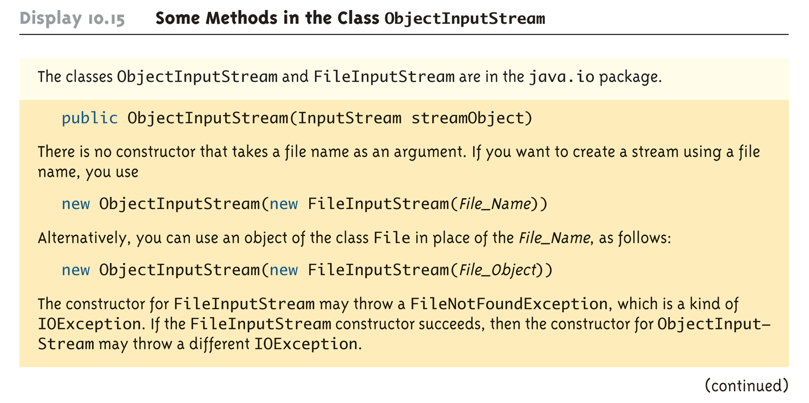
Some Methods in the Class ObjectInputStream (Part 1 of 5)

Slide 88
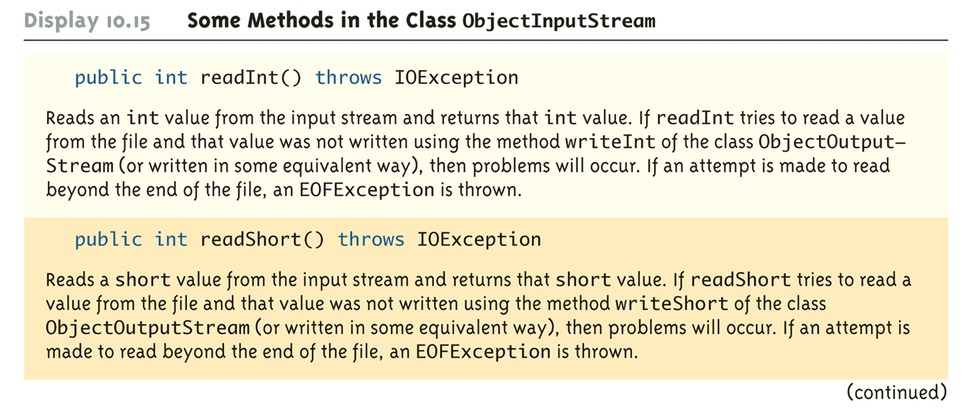
Some Methods in the Class ObjectInputStream (Part 2 of 5)

Slide 89
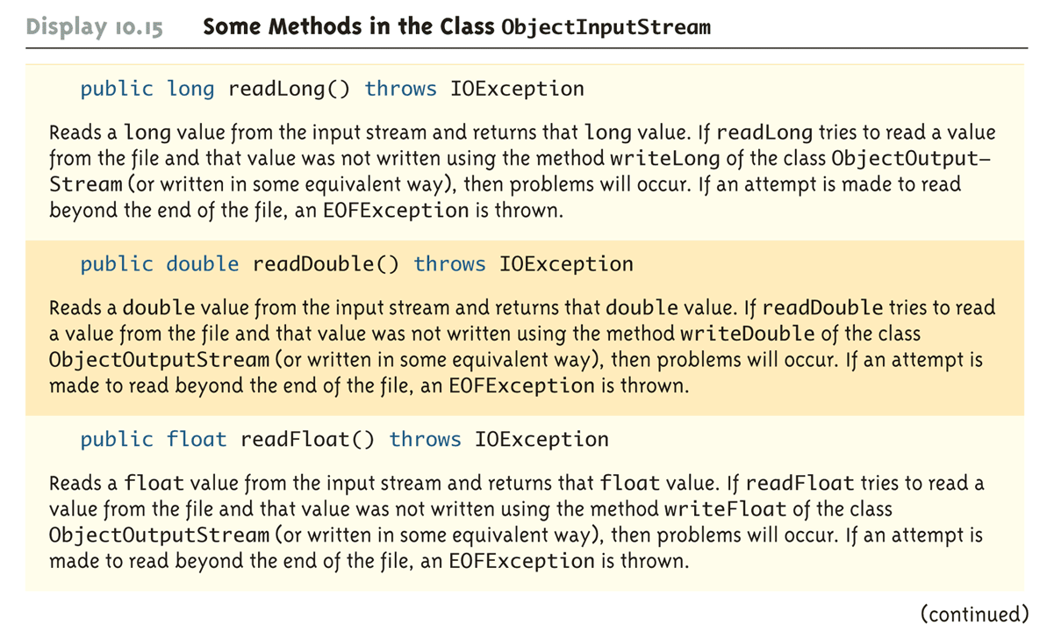
Some Methods in the Class ObjectInputStream (Part 3 of 5)

Slide 90
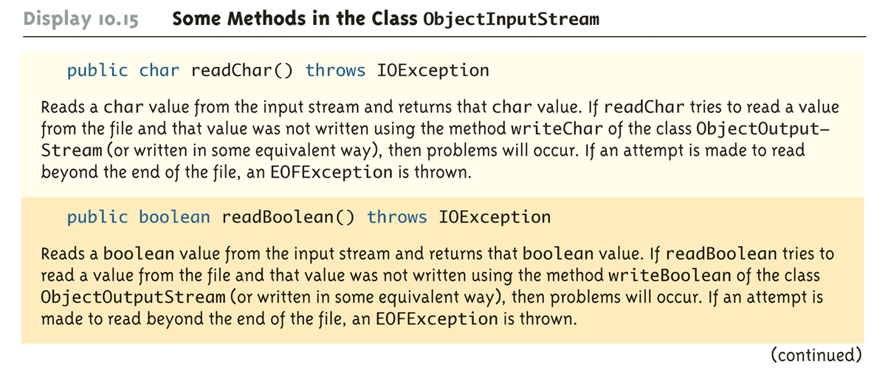
Some Methods in the Class ObjectInputStream (Part 4 of 5)

Slide 91
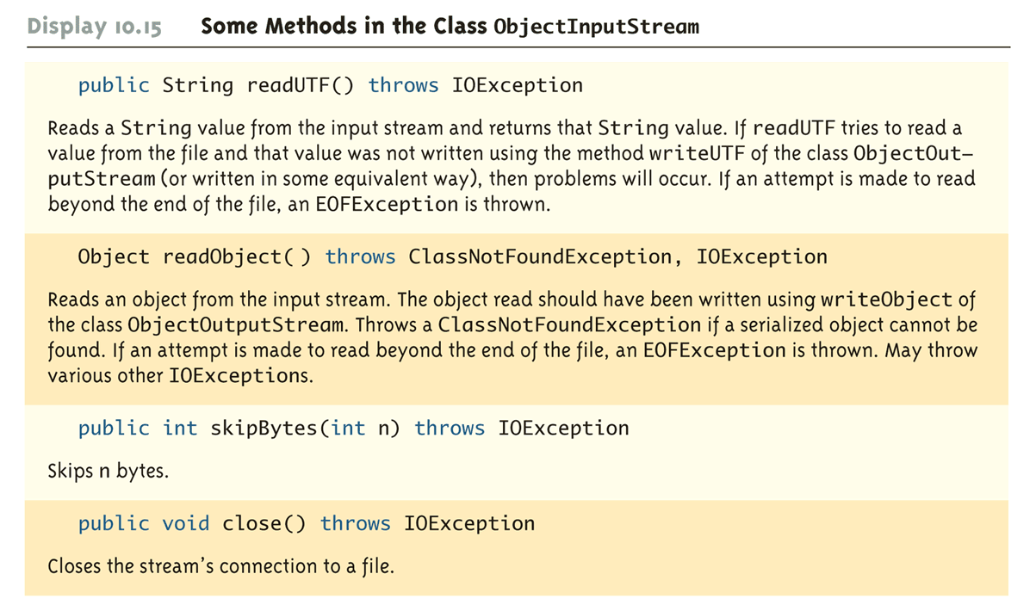
Some Methods in the Class ObjectInputStream (Part 5 of 5)

Slide 92
Checking for the End of a Binary File the Correct Way
All of the ObjectInputStream methods that read from a binary file throw an EOFException when trying to read beyond the end of a file
This can be used to end a loop that reads all the data in a file
Note that different file-reading methods check for the end of a file in different ways
Testing for the end of a file in the wrong way can cause a program to go into an infinite loop or terminate abnormally

Slide 93
Binary I/O of Objects
Objects can also be input and output from a binary file
Use the writeObject method of the class ObjectOutputStream to write an object to a binary file
Use the readObject method of the class ObjectInputStream to read an object from a binary file
In order to use the value returned by readObject as an object of a class, it must be type cast first:
SomeClass someObject =
(SomeClass)objectInputStream.readObject();

Slide 94
Binary I/O of Objects
It is best to store the data of only one class type in any one file
Storing objects of multiple class types or objects of one class type mixed with primitives can lead to loss of data
In addition, the class of the object being read or written must implement the Serializable interface
The Serializable interface is easy to use and requires no knowledge of interfaces
A class that implements the Serializable interface is said to be a serializable class

Slide 95
The Serializable Interface
In order to make a class serializable, simply add implements Serializable to the heading of the class definition
public class SomeClass implements Serializable
When a serializable class has instance variables of a class type, then all those classes must be serializable also
A class is not serializable unless the classes for all instance variables are also serializable for all levels of instance variables within classes

Slide 96
Array Objects in Binary Files
Since an array is an object, arrays can also be read and written to binary files using readObject and writeObject
If the base type is a class, then it must also be serializable, just like any other class type
Since readObject returns its value as type Object (like any other object), it must be type cast to the correct array type:
SomeClass[] someObject =
(SomeClass[])objectInputStream.readObject();

Slide 97
Random Access to Binary Files
The streams for sequential access to files are the ones most commonly used for file access in Java
However, some applications require very rapid access to records in very large databases
These applications need to have random access to particular parts of a file

Slide 98
Reading and Writing to the Same File
The stream class RandomAccessFile, which is in the java.io package, provides both read and write random access to a file in Java
A random access file consists of a sequence of numbered bytes
There is a kind of marker called the file pointer that is always positioned at one of the bytes
All reads and writes take place starting at the file pointer location
The file pointer can be moved to a new location with the method seek

Slide 99
Reading and Writing to the Same File
Although a random access file is byte oriented, there are methods that allow for reading or writing values of the primitive types as well as string values to/from a random access file
These include readInt, readDouble, and readUTF for input, and writeInt, writeDouble, and writeUTF for output
It does no have writeObject or readObject methods, however

Slide 100
Opening a File
The constructor for RandomAccessFile takes either a string file name or an object of the class File as its first argument
The second argument must be one of four strings:
"rw", meaning the code can both read and write to the file after it is open
"r", meaning the code can read form the file, but not write to it
"rws" or "rwd" (See Table of methods from RandomAccessFile)

Slide 101
Pitfall: A Random Access File Need Not Start Empty
If the file already exists, then when it is opened, the length is not reset to 0, and the file pointer will be positioned at the start of the file
This ensures that old data is not lost, and that the file pointer is set for the most likely position for reading (not writing)
The length of the file can be changed with the setLength method
In particular, the setLength method can be used to empty the file

Slide 102
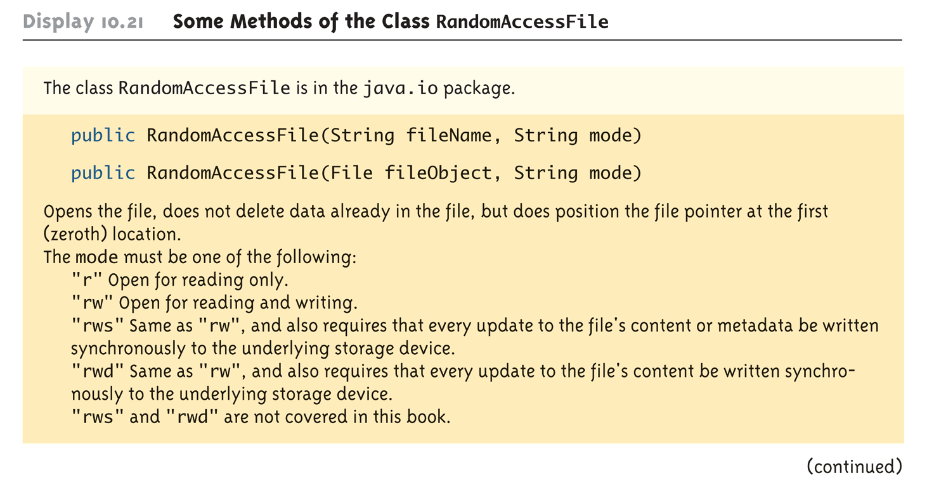
Some Methods of the Class RandomAccessFile (Part 1 of 7)

Slide 103
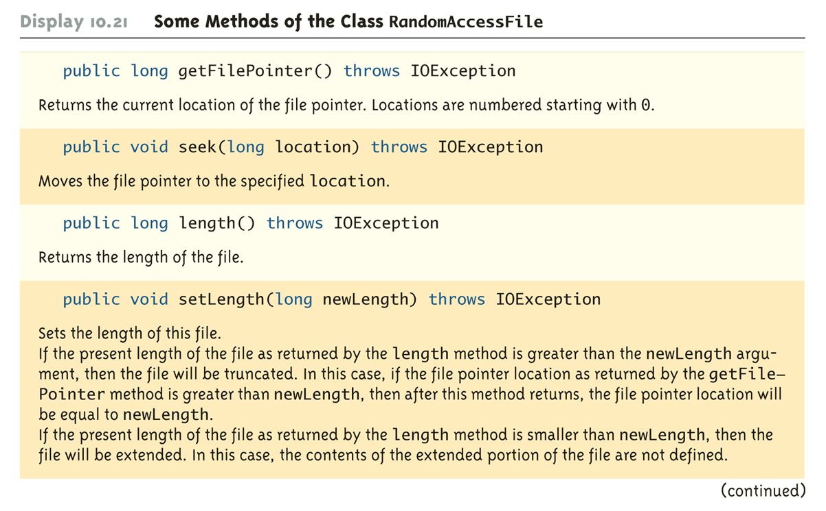
Some Methods of the Class RandomAccessFile (Part 2 of 7)

Slide 104
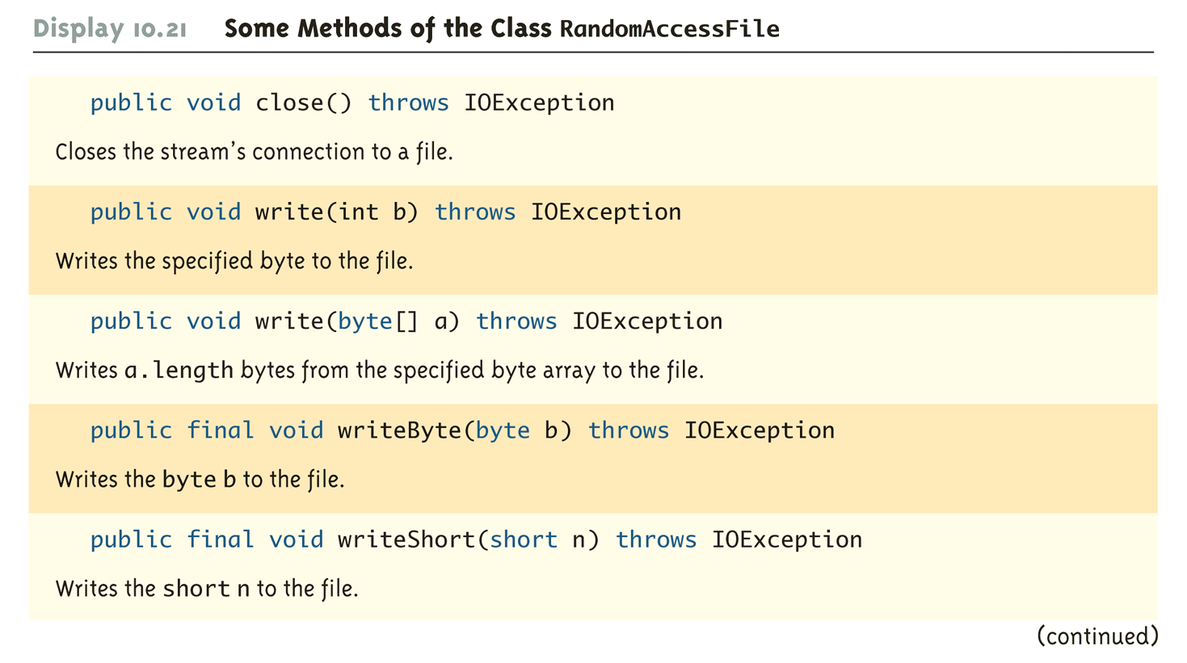
Some Methods of the Class RandomAccessFile (Part 3 of 7)

Slide 105
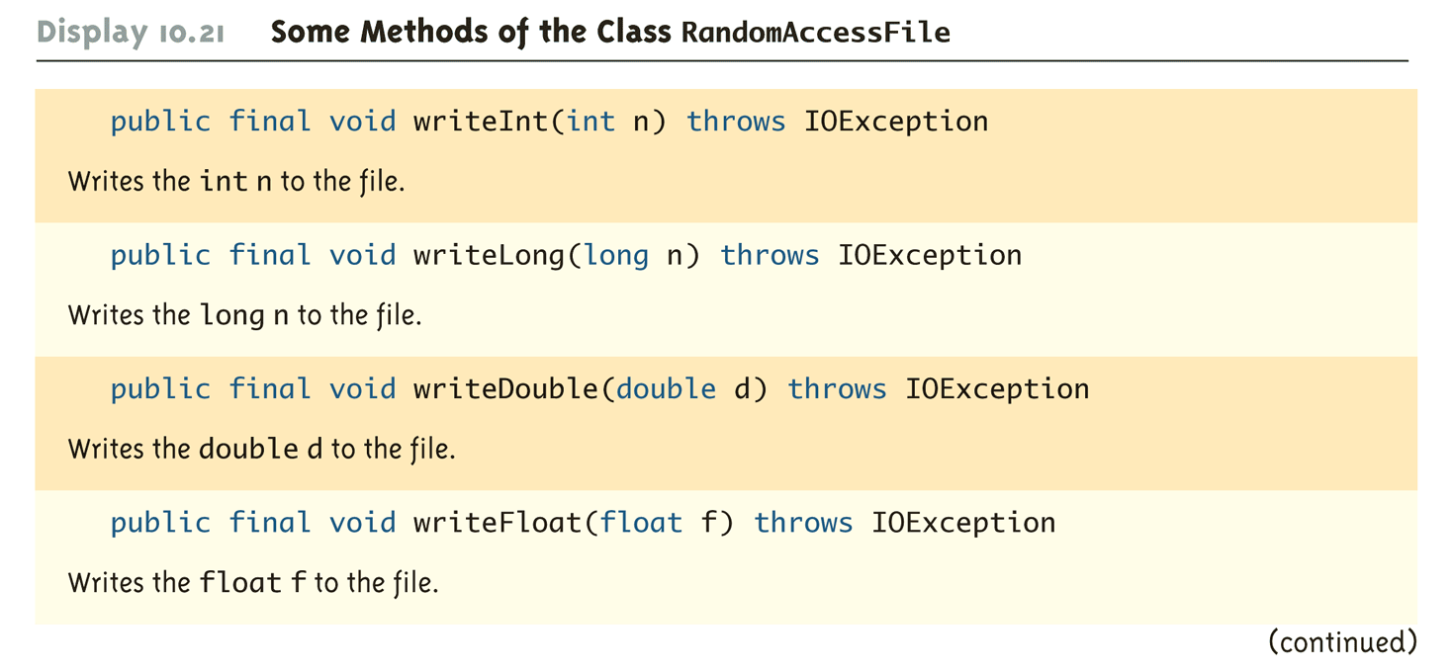
Some Methods of the Class RandomAccessFile (Part 4 of 7)

Slide 106
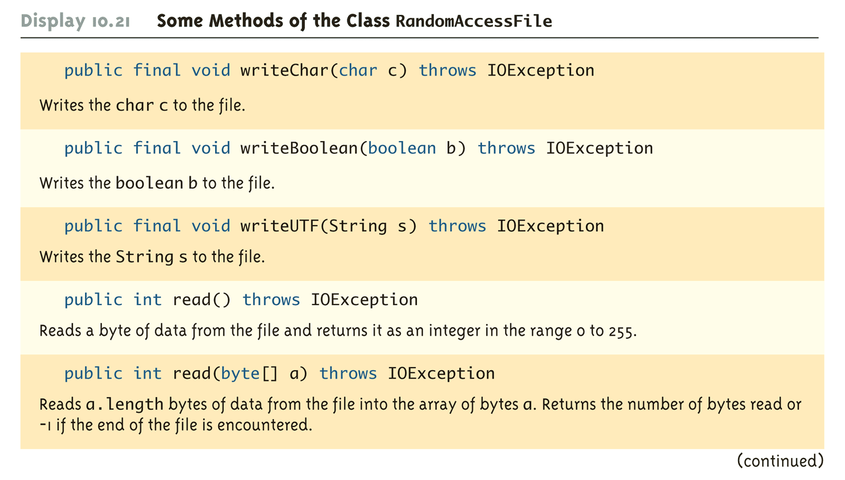
Some Methods of the Class RandomAccessFile (Part 5 of 7)

Slide 107
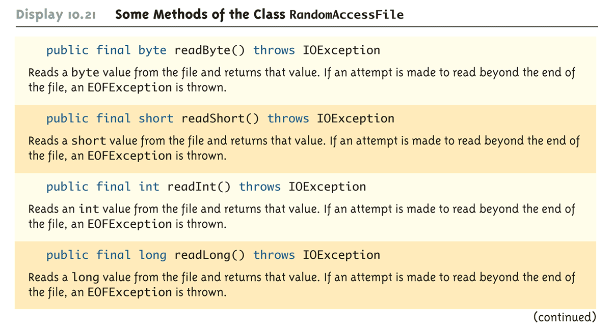
Some Methods of the Class RandomAccessFile (Part 6 of 7)

Slide 108

Some Methods of the Class RandomAccessFile (Part 7 of 7)

